Slide 1




OLIST E-COMMERCE
ANALYSIS
A DEEP DIVE INTO OLIST’S SALES, SELLERS,
AND CUSTOMER BEHAVIOR
POWER BI DEVELOPMENT TRACK
ITP - 2025 - Q2
ITI MANSOURA

Slide 2
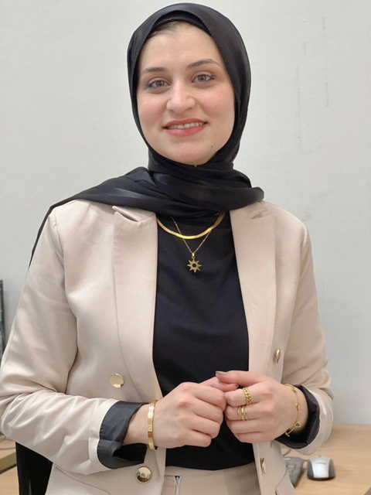

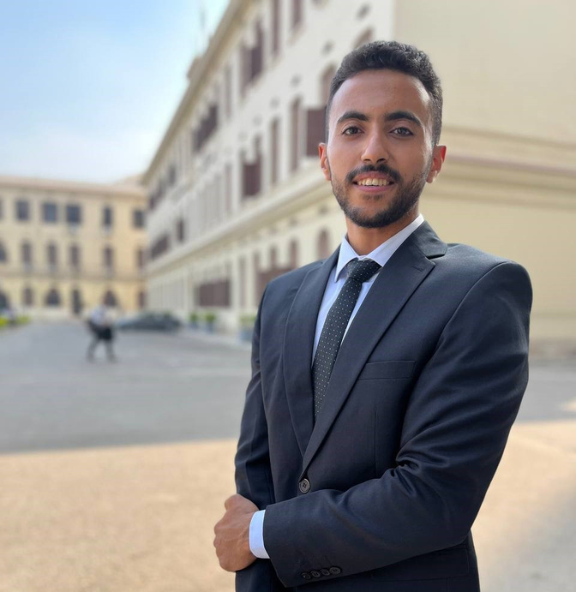
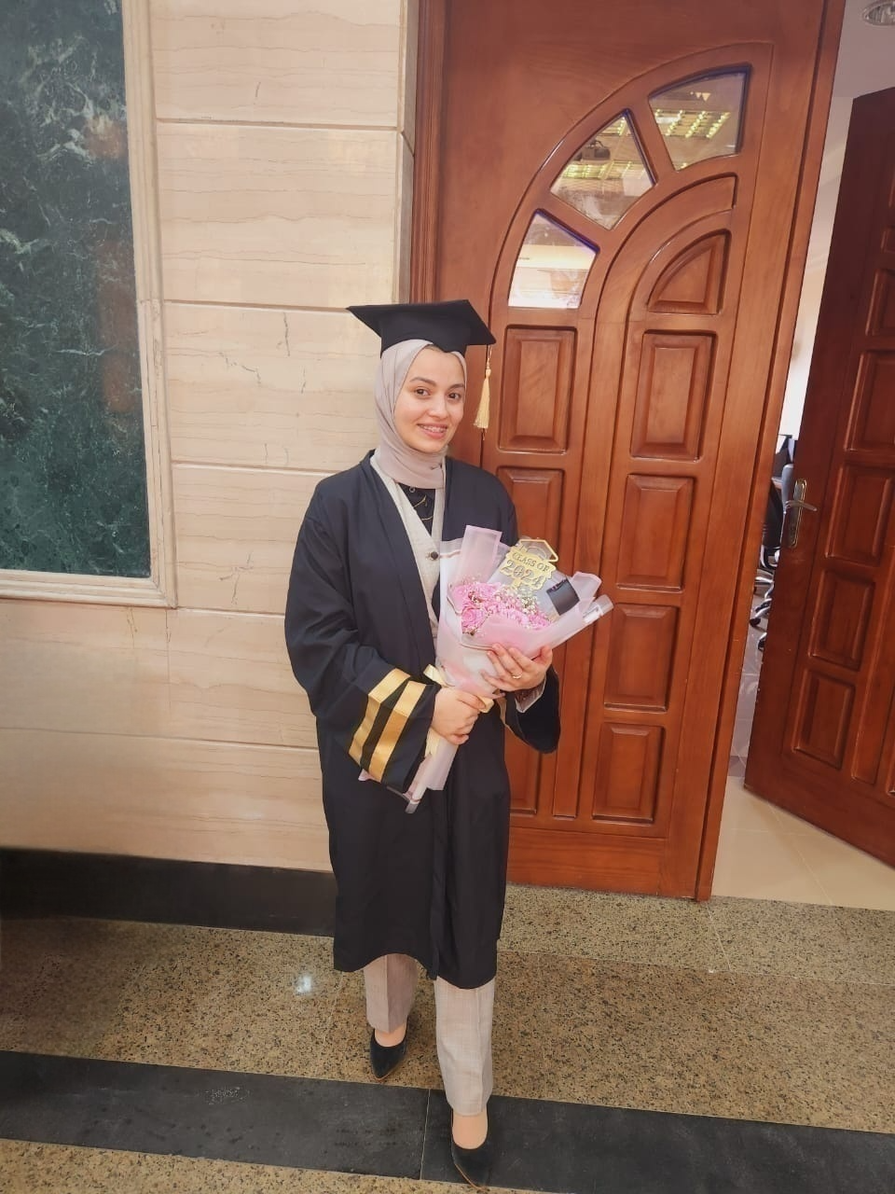
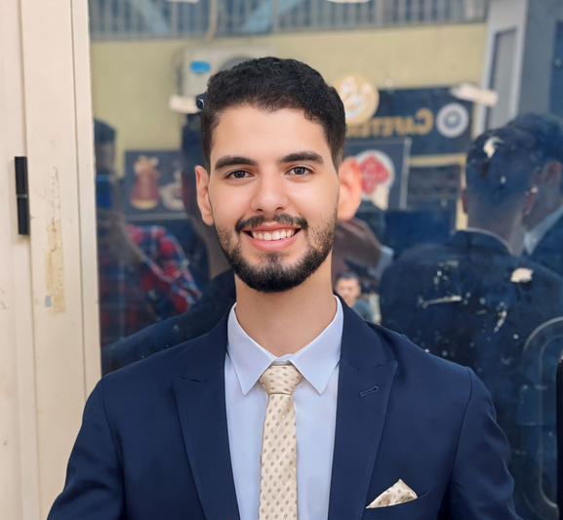
TEAM MEMBERS
“TEAM 05”
Sarah Fikry
Usama Elmaghraby
Abdelrhman Samir
Nafisa Elkady
Abdelrahman Saleh

Slide 3


OVERVIEW
Olist is a Brazilian e-commerce platform that connects small businesses with major online marketplaces, enabling them to sell products efficiently.
ITP - Q2 - PBI - 2025
ITI MANSOURA

Slide 4
01 Gen AI
02 ERD
03 Database Modeling
04 ETL process “Database”
AGENDA
05 Dimensional Modeling “DWH”
06 ETL process “DWH”
07 Analysis with SSAS
08 SSRS Reports
09 Power BI Dashboard
10 Tableau Dashboard
ITP - Q2 - PBI - 2025
ITI MANSOURA

Slide 5
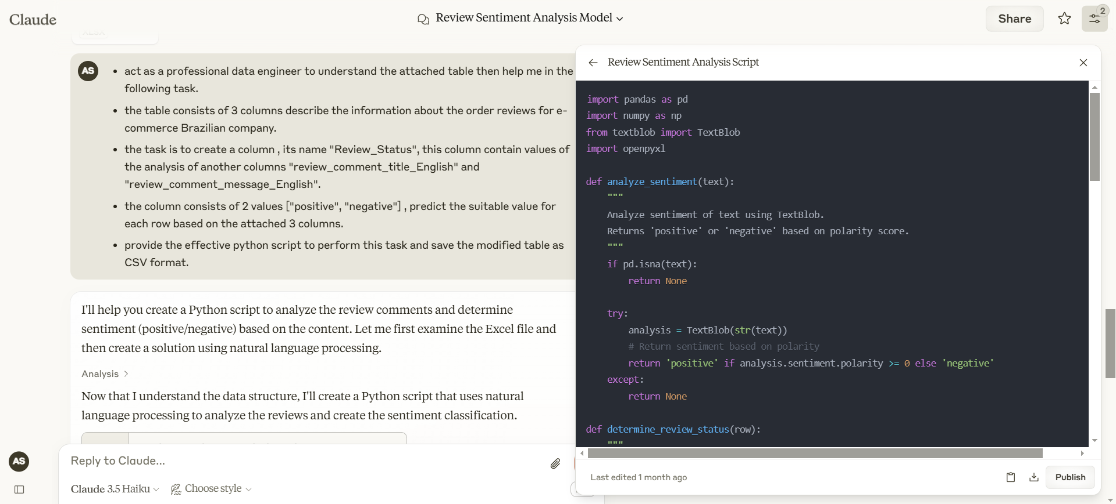
01) GEN AI
Enhancing data by generation with the power
of Claude AI
Prompt
Response
ITP - Q2 - PBI - 2025
ITI MANSOURA

Slide 6
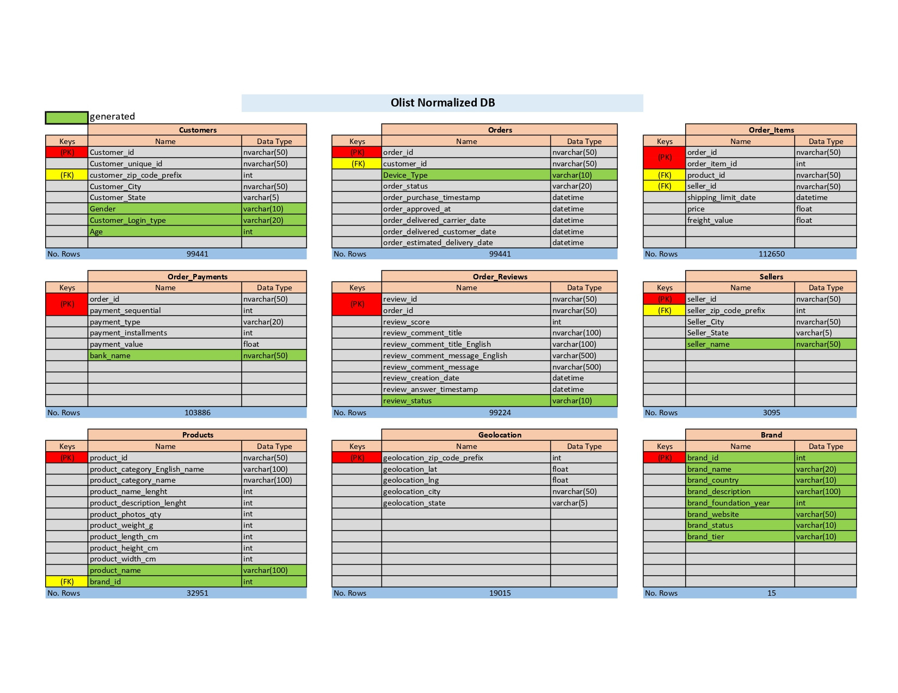
01) GEN AI
Enhancing dataset by adding some generated fields to the tables.
ITP - Q2 - PBI - 2025
ITI MANSOURA

Slide 7
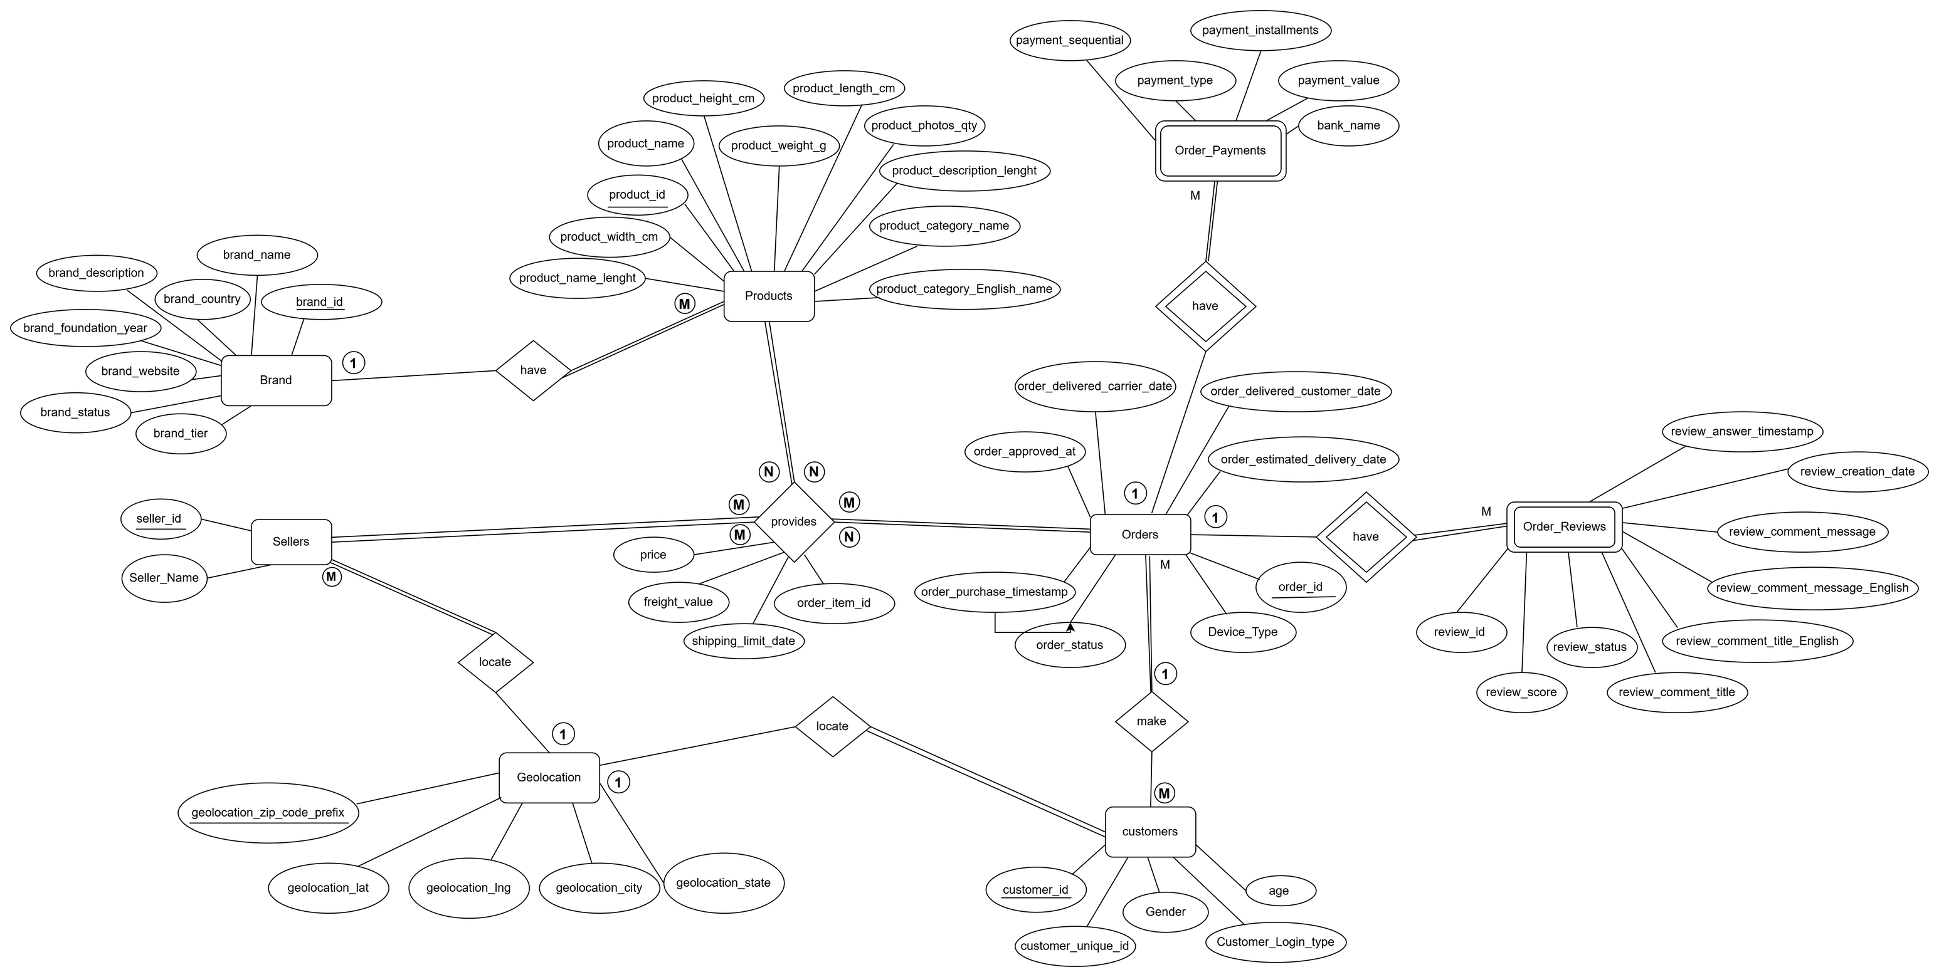
02) ERD
ERD
ITP - Q2 - PBI - 2025
ITI MANSOURA

Slide 8
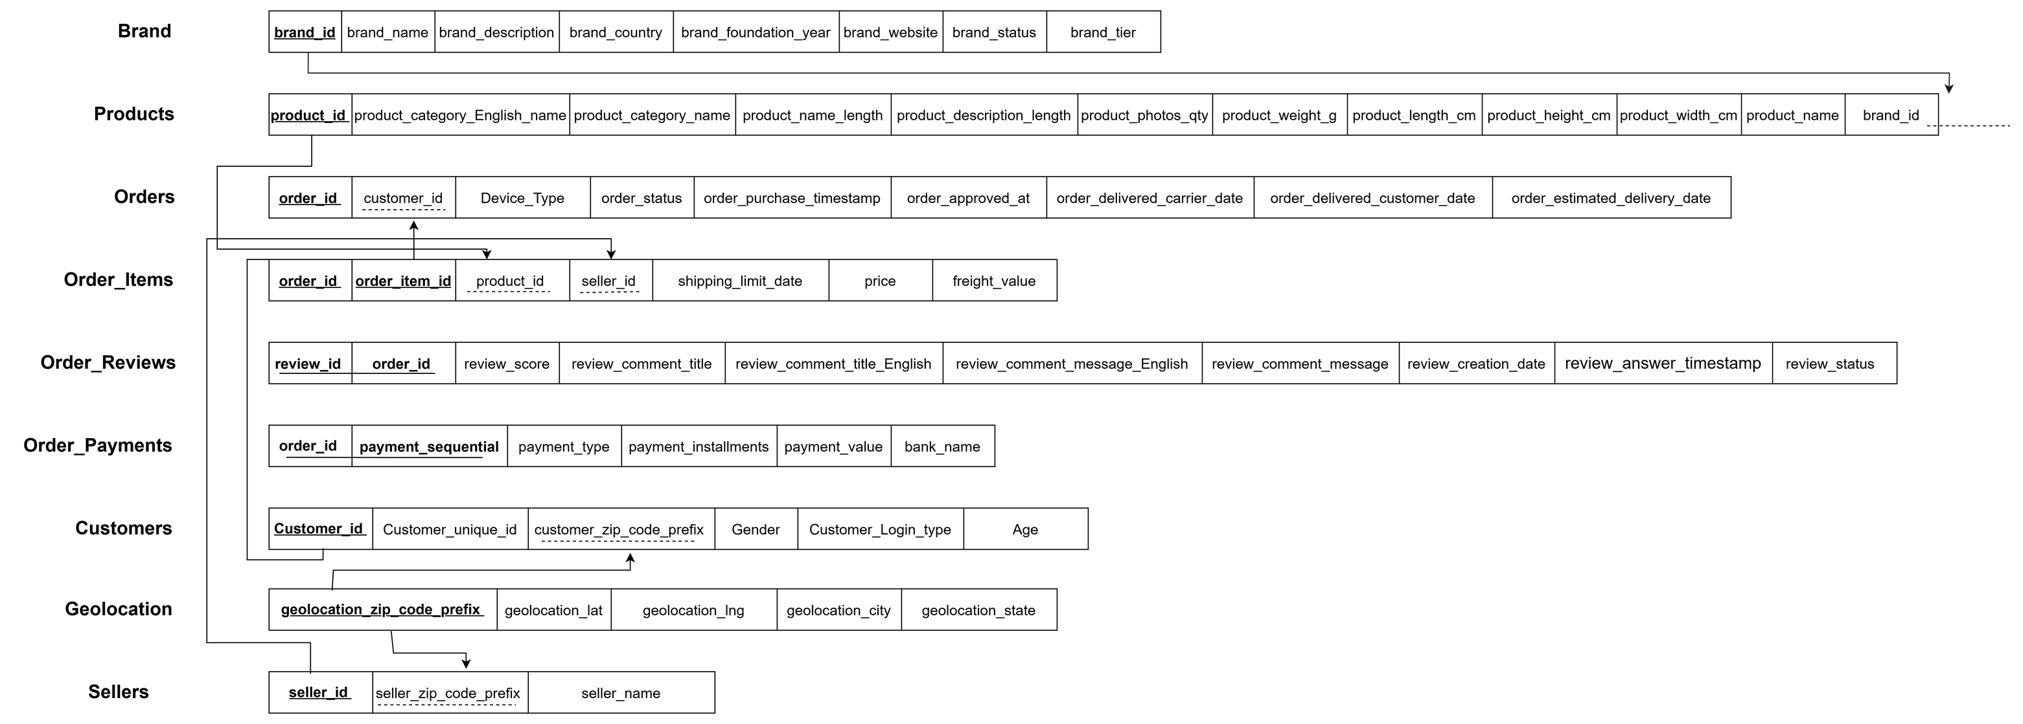
03) DATABASE MODELING
ITP - Q2 - PBI - 2025
ITI MANSOURA

Slide 9
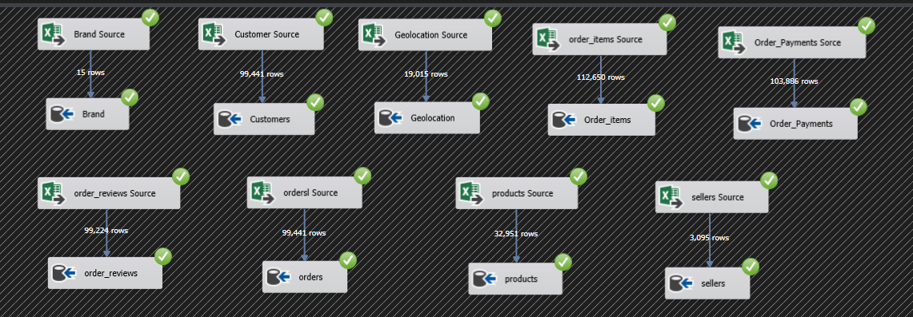
04) ETL PROCESS “DATABASE”
Transforming data from Excel to a structured database through
the ETL process using SSIS.
ITP - Q2 - PBI - 2025
ITI MANSOURA

Slide 10
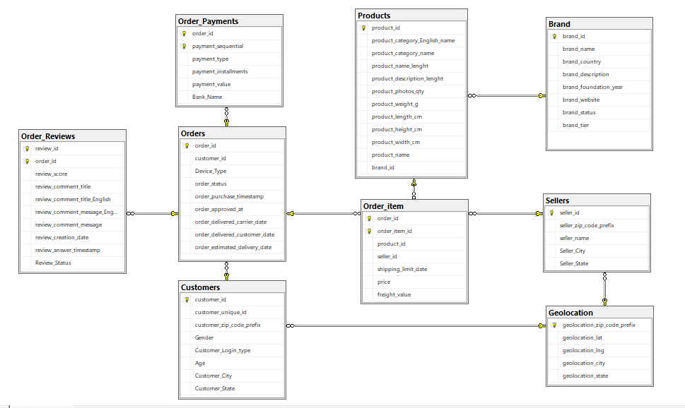
04) ETL PROCESS “DATABASE”
Transforming data from Excel to a structured database through
the ETL process using SSIS.
ITP - Q2 - PBI - 2025
ITI MANSOURA

Slide 11
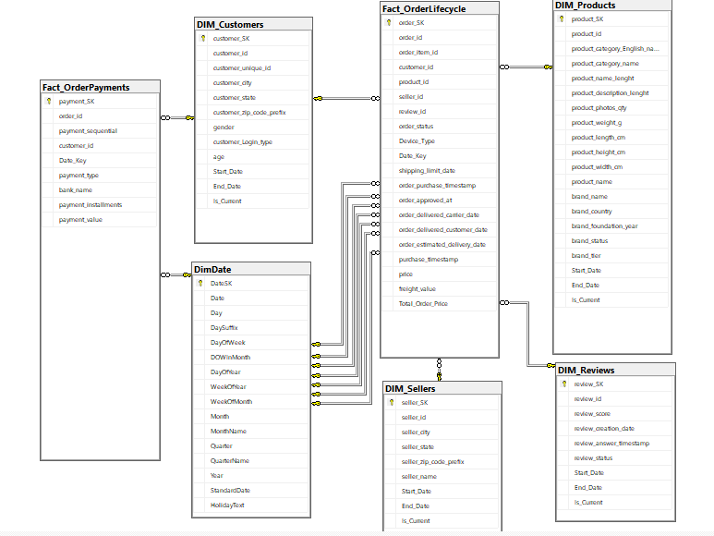
05) DIMENSIONAL MODELING “DWH”
Optimizing analytics with Galaxy Schema, leveraging multiple fact tables for a scalable and efficient Data Warehouse
ITP - Q2 - PBI - 2025
ITI MANSOURA

Slide 12
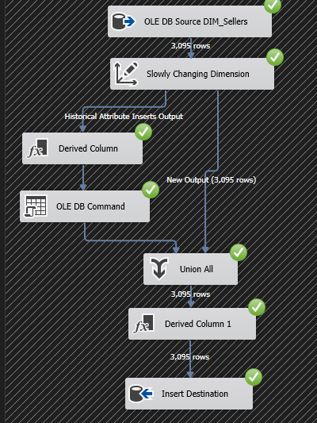
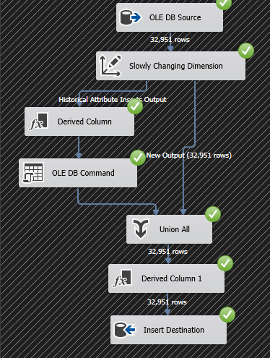
06) ETL PROCESS “DWH”
Slowly Changing Dimensions (SCD) in Data Warehouse
Sellers Dimension
Products Dimension
ITP - Q2 - PBI - 2025
ITI MANSOURA

Slide 13
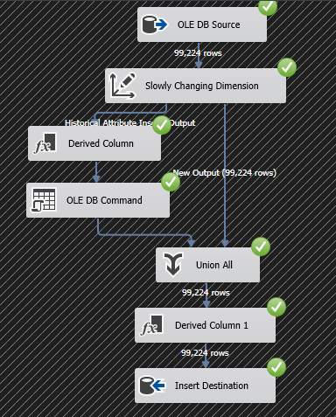
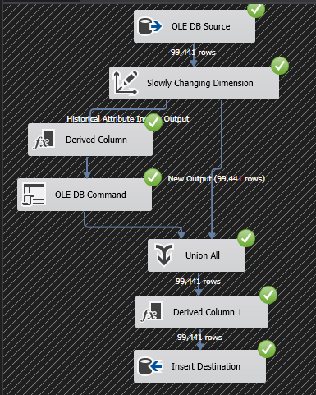
06) ETL PROCESS “DWH”
Slowly Changing Dimensions (SCD) in Data Warehouse
Reviews Dimension
Customers Dimension
ITP - Q2 - PBI - 2025
ITI MANSOURA

Slide 14
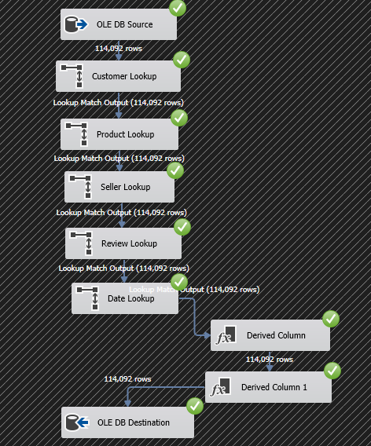
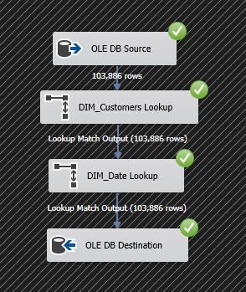
06) ETL PROCESS “DWH”
Fact Order Life Cycle
“Orders + Order Item table in DB”
Fact Order Payments
“Order Payments table in DB”
ITP - Q2 - PBI - 2025
ITI MANSOURA

Slide 15
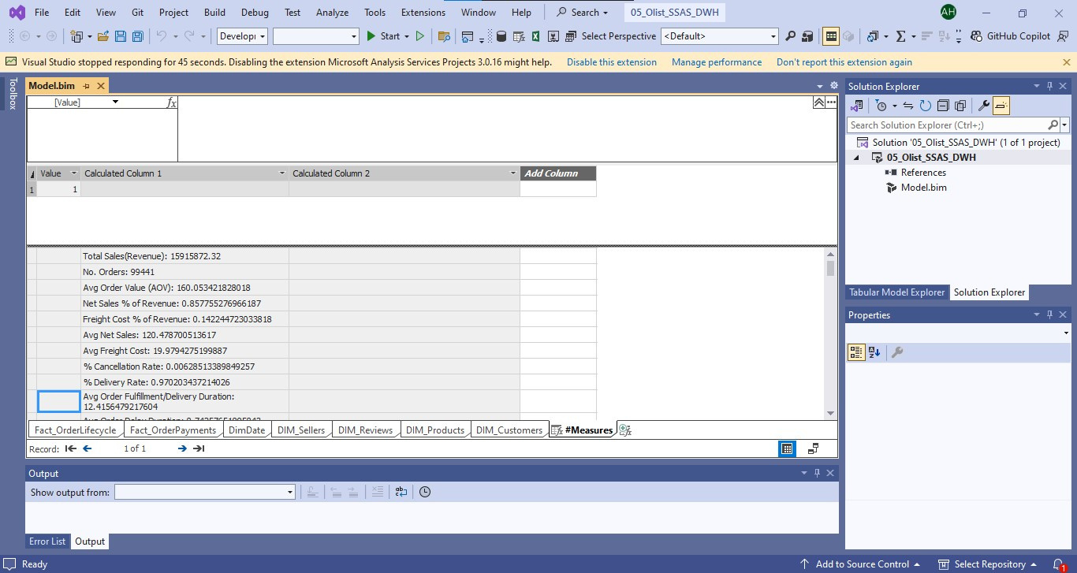
07) ANALYSIS WITH SSAS
ITP - Q2 - PBI - 2025
ITI MANSOURA

Slide 16
08) SSRS REPORTS
ITP - Q2 - PBI - 2025
ITI MANSOURA

Slide 17
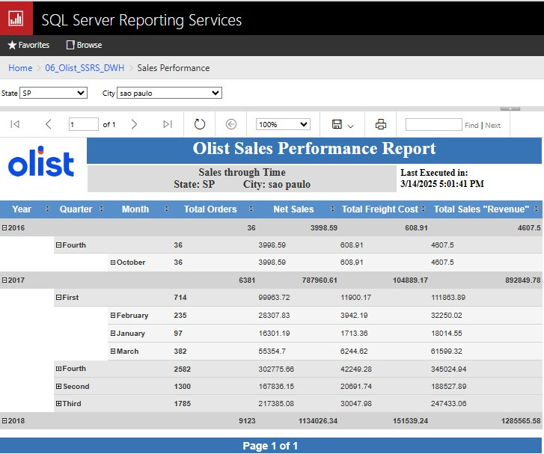
Sales Performance Report
“SSAS Data Source”
ITP - Q2 - PBI - 2025
ITI MANSOURA

Slide 18
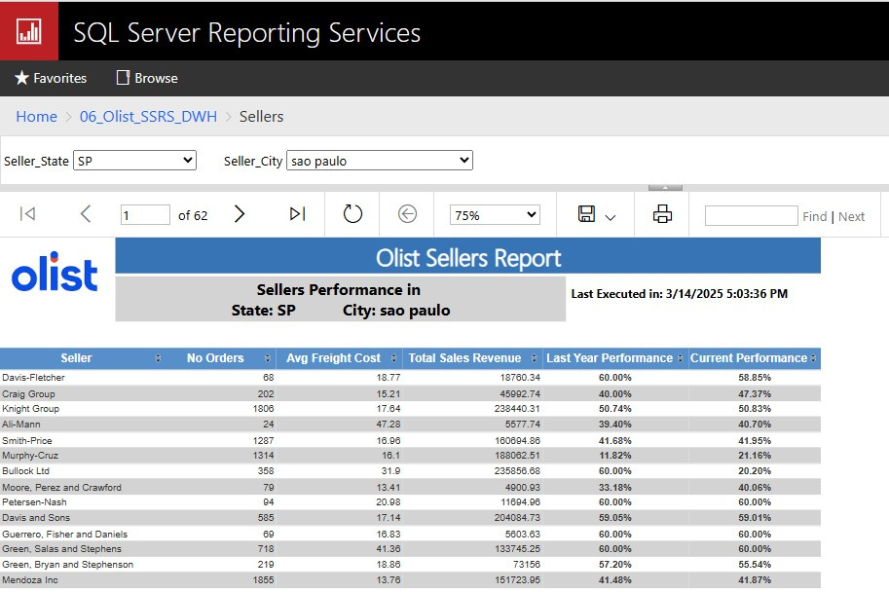
Sellers Report
“SSAS Data Source”
ITP - Q2 - PBI - 2025
ITI MANSOURA

Slide 19
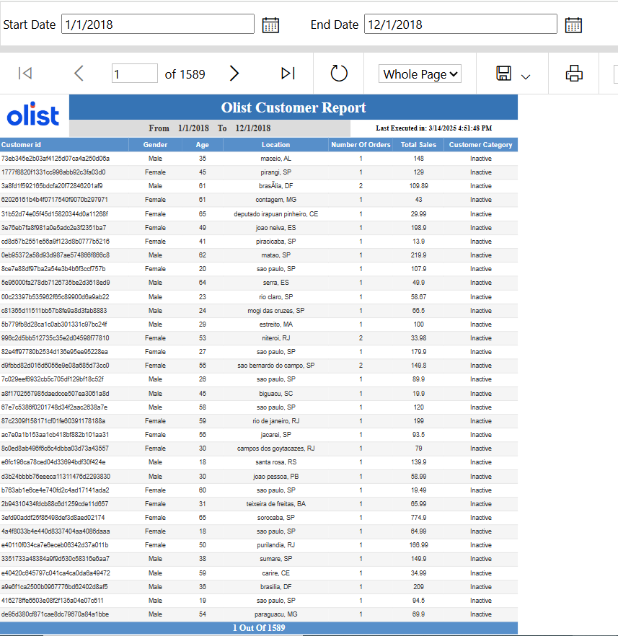
Customers Report
“Stored Procedure Data Source”
ITP - Q2 - PBI - 2025
ITI MANSOURA

Slide 20
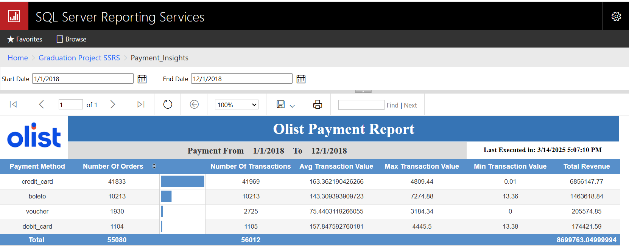
Payment Report
“Stored Procedure Data Source”
ITP - Q2 - PBI - 2025
ITI MANSOURA

Slide 21
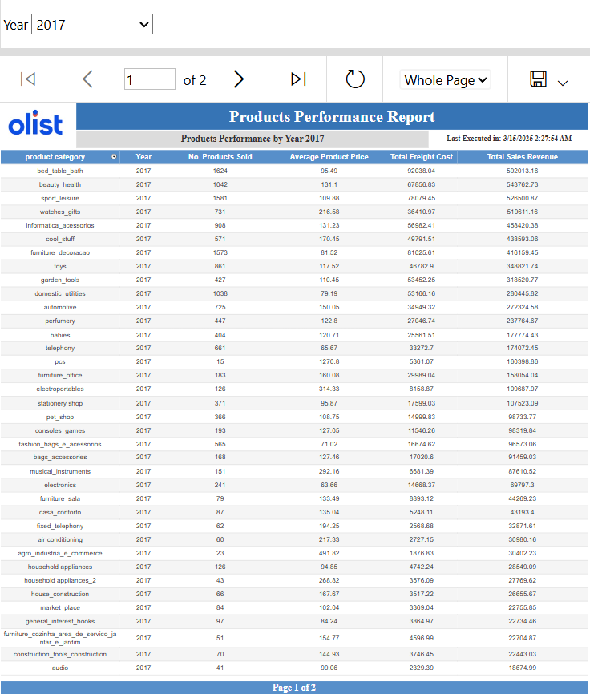
Product Performance Report
“SSAS Data Source”
ITP - Q2 - PBI - 2025
ITI MANSOURA

Slide 22
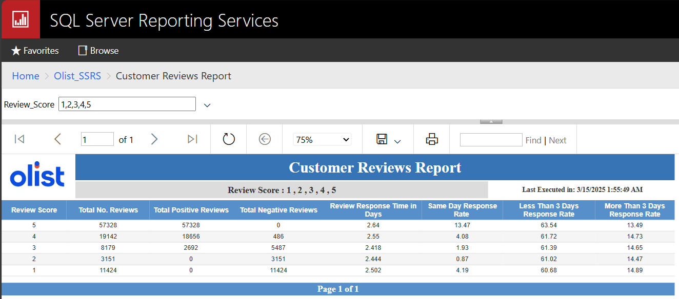
Review Report
“SSAS Data Source”
ITP - Q2 - PBI - 2025
ITI MANSOURA

Slide 23
09) POWER BI DASHBOARDS
ITP - Q2 - PBI - 2025
ITI MANSOURA

Slide 24
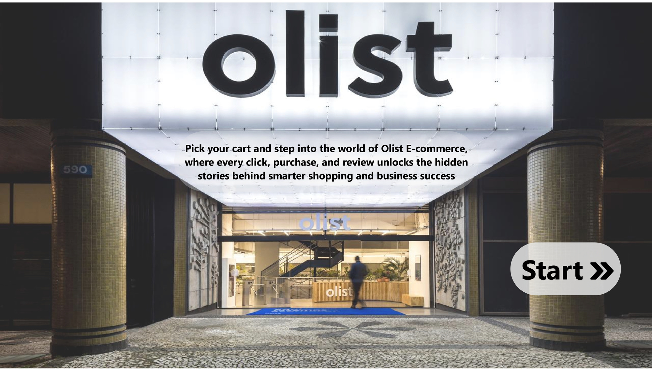
COVER PAGE
ITP - Q2 - PBI - 2025
ITI MANSOURA

Slide 25
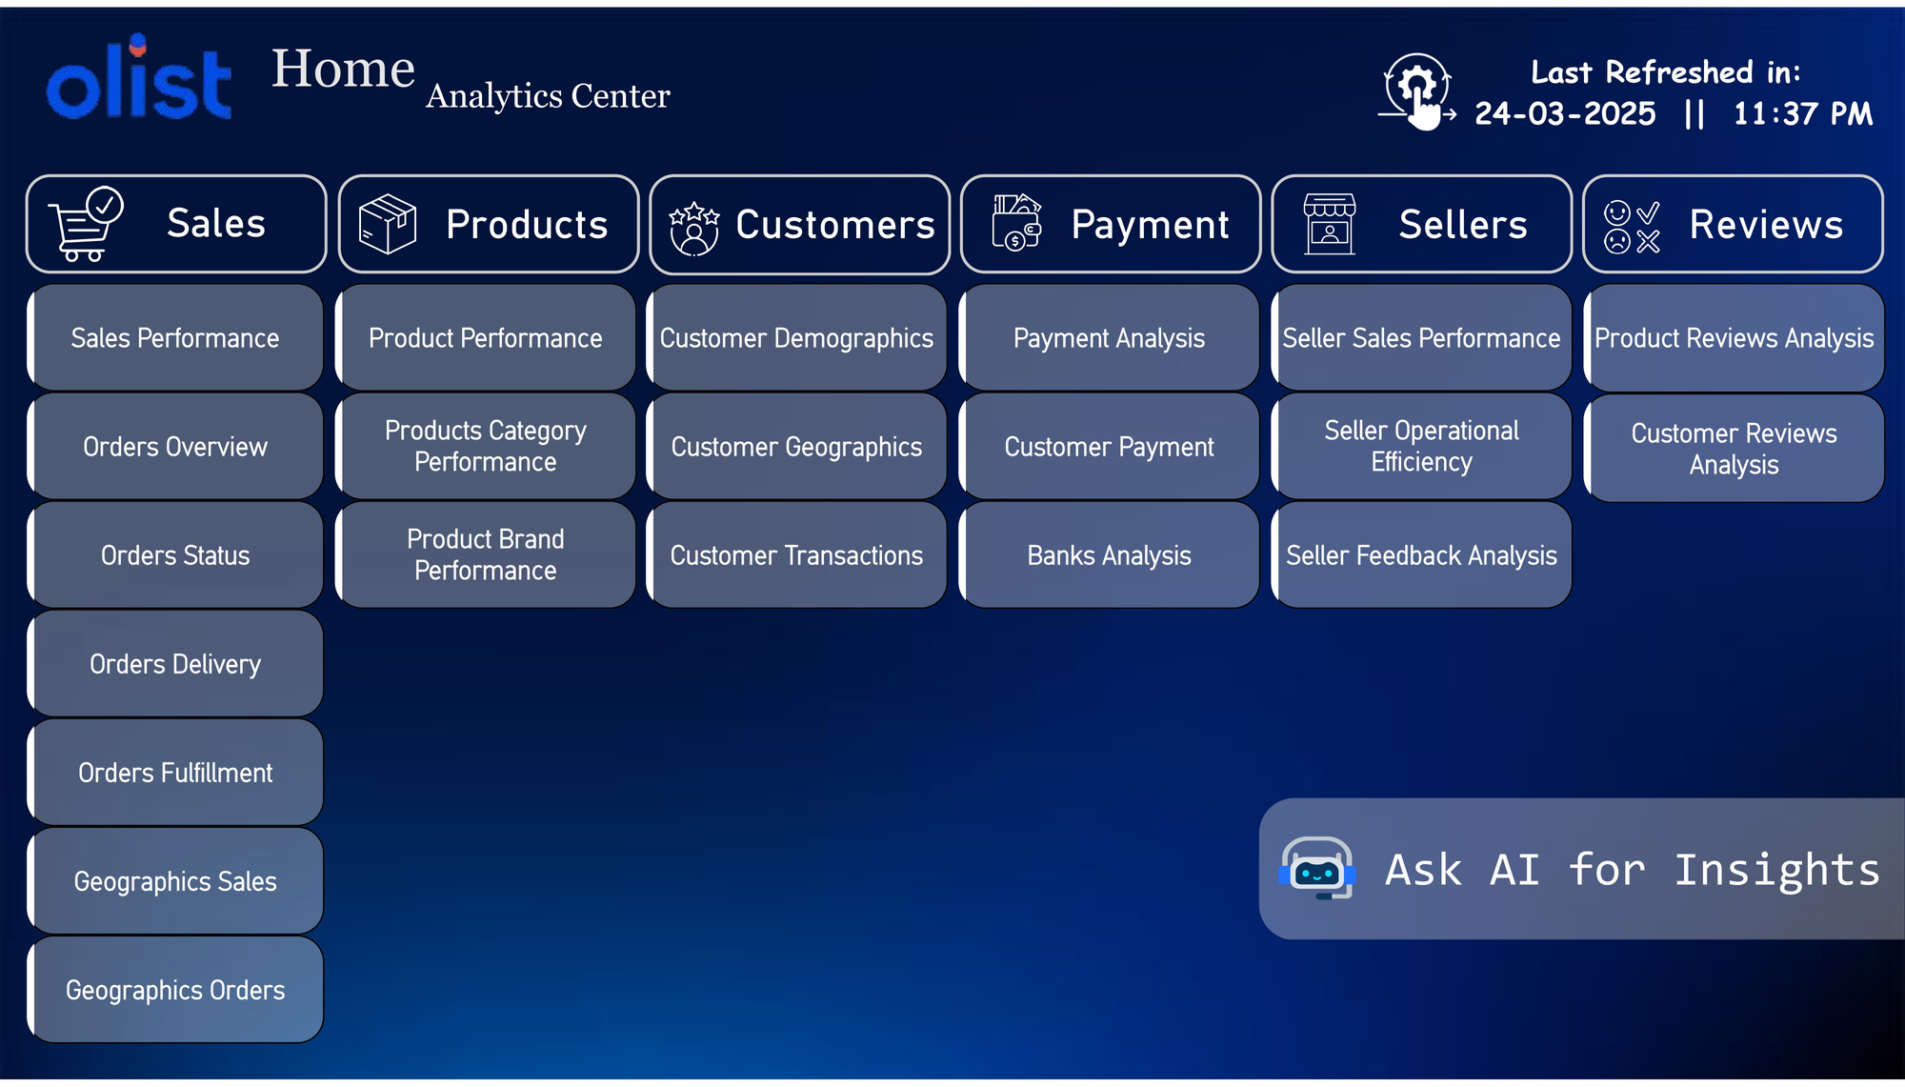
HOME PAGE
ITP - Q2 - PBI - 2025
ITI MANSOURA

Slide 26
SALES & ORDERS DASHBOARDS
ITP - Q2 - PBI - 2025
ITI MANSOURA

Slide 27
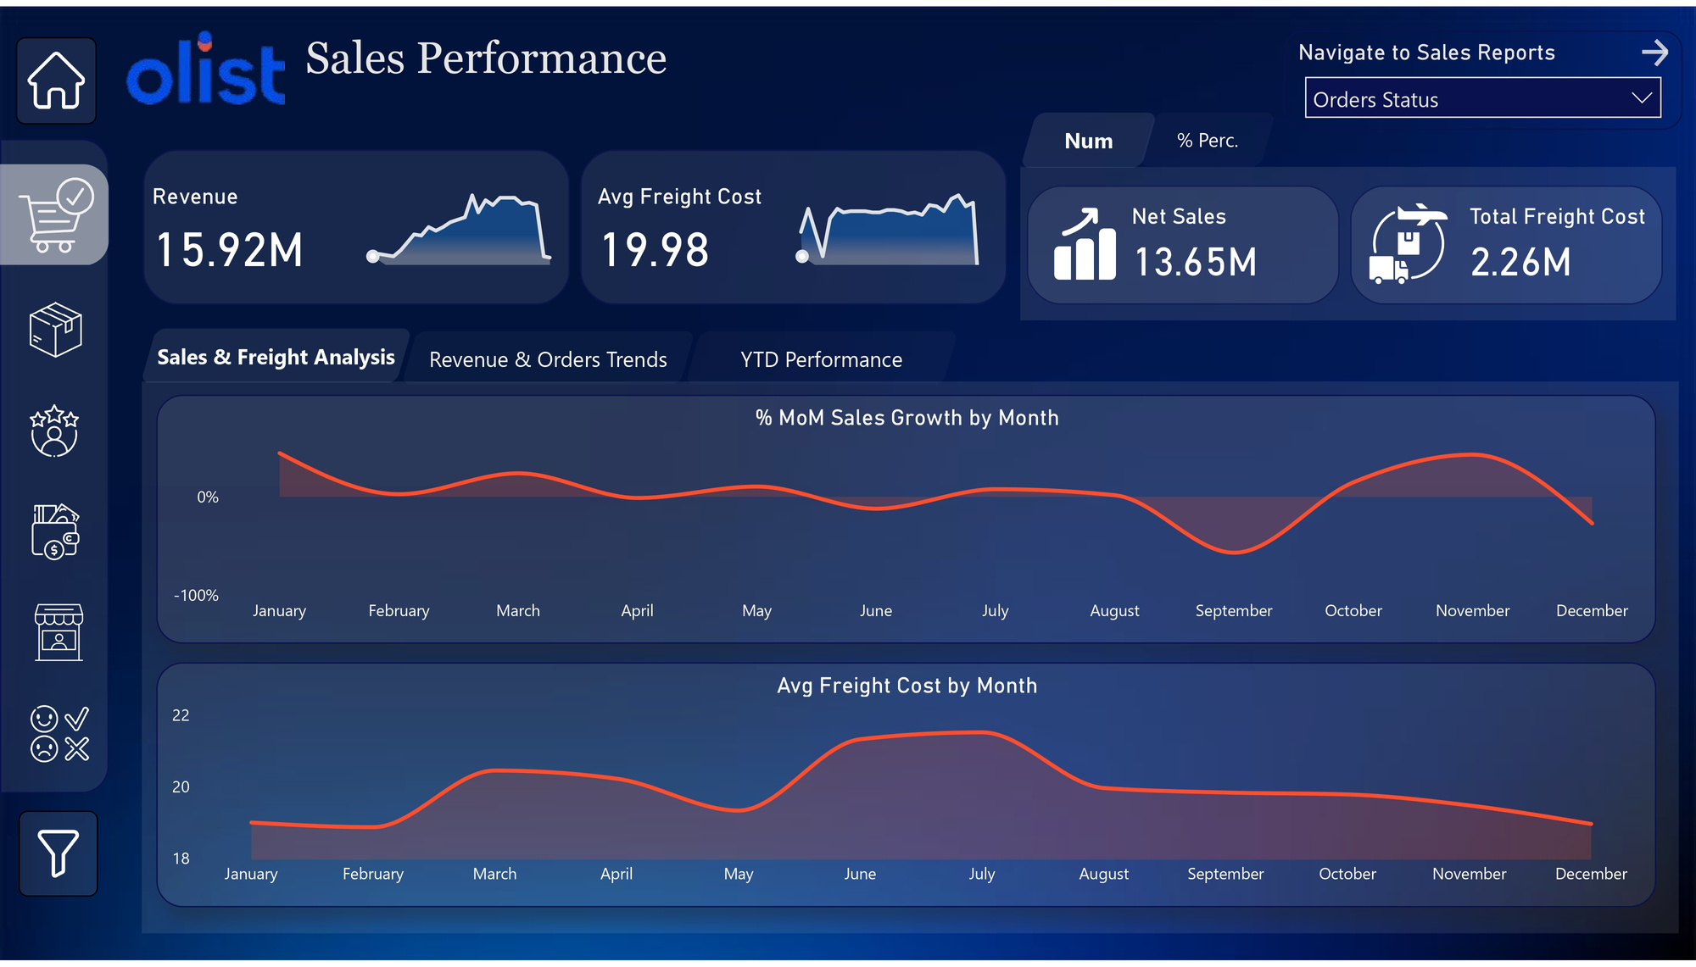
Recommendations:
Identify the causes of declining sales months “September”, Analyze seasonality
and adjust promotions.
Consider offering incentives for customers to choose cost-effective shipping options.
ITP - Q2 - PBI - 2025
ITI MANSOURA

Slide 28
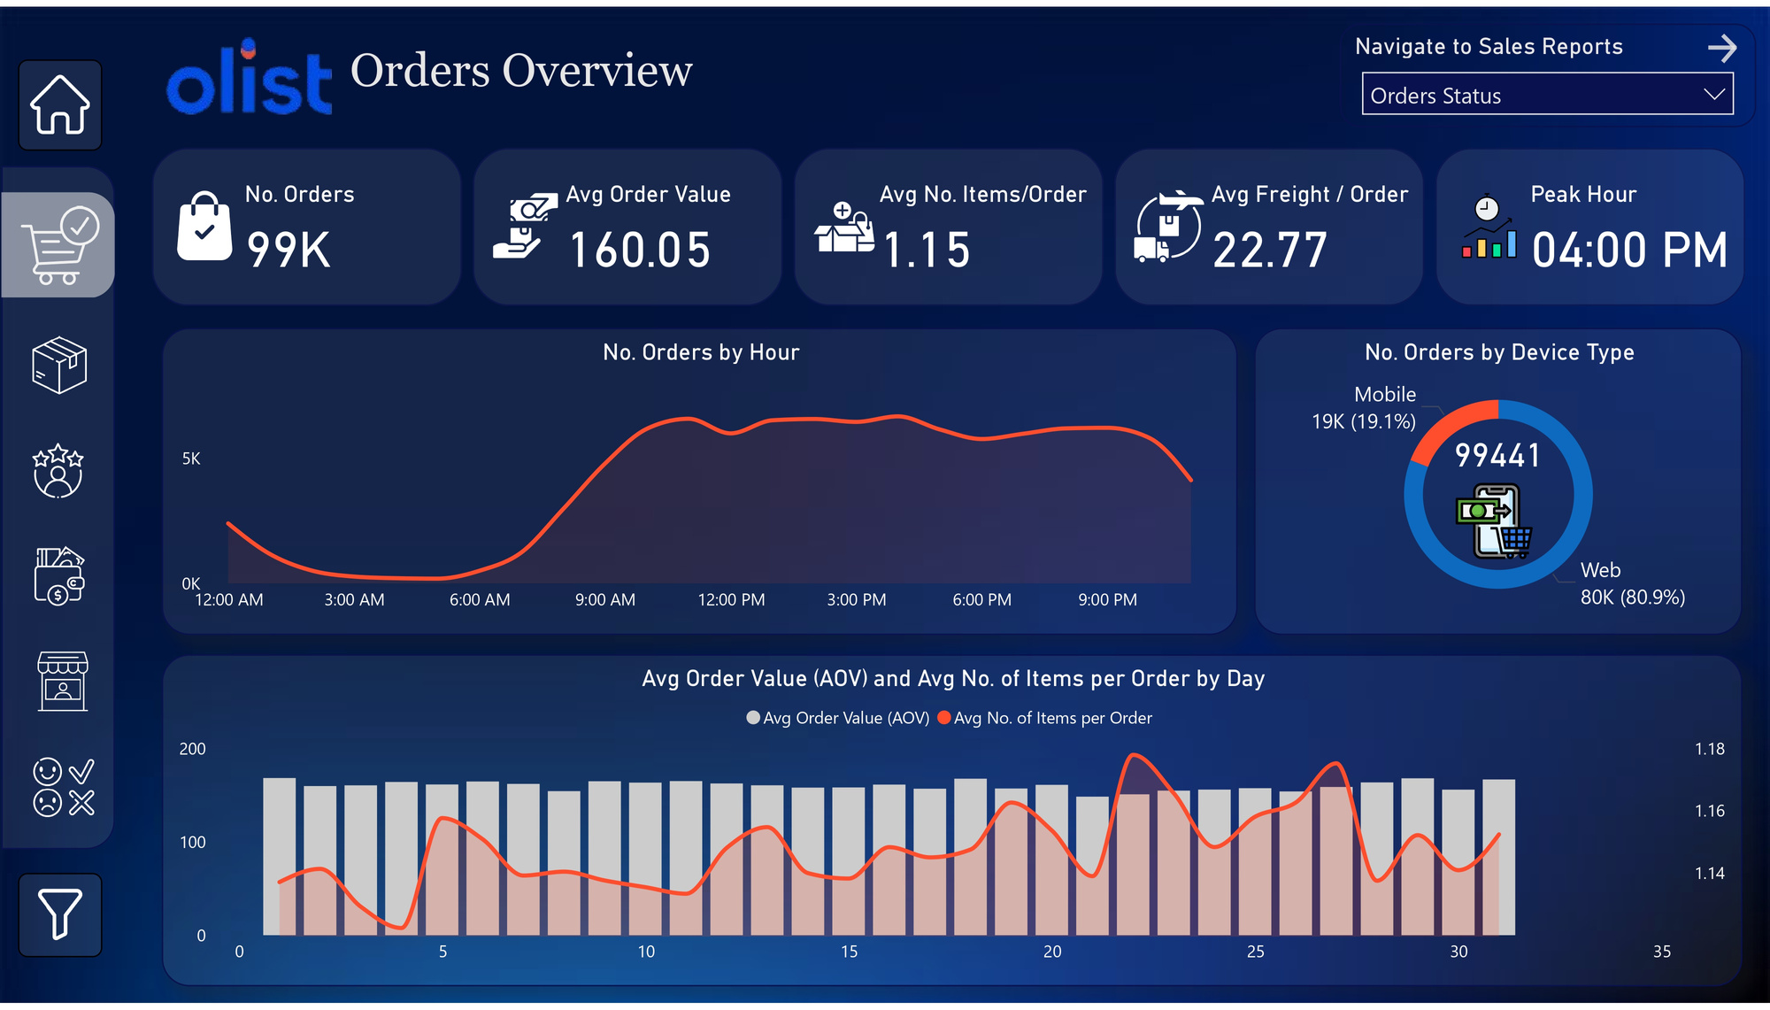
Recommendations:
Leverage the peak order hour (4:00 PM) by offering time-limited promotions or discounts to further boost sales during this period.
Improve the mobile shopping experience by optimizing the app.
Offer exclusive mobile-only deals to increase mobile order volume.
ITP - Q2 - PBI - 2025
ITI MANSOURA

Slide 29
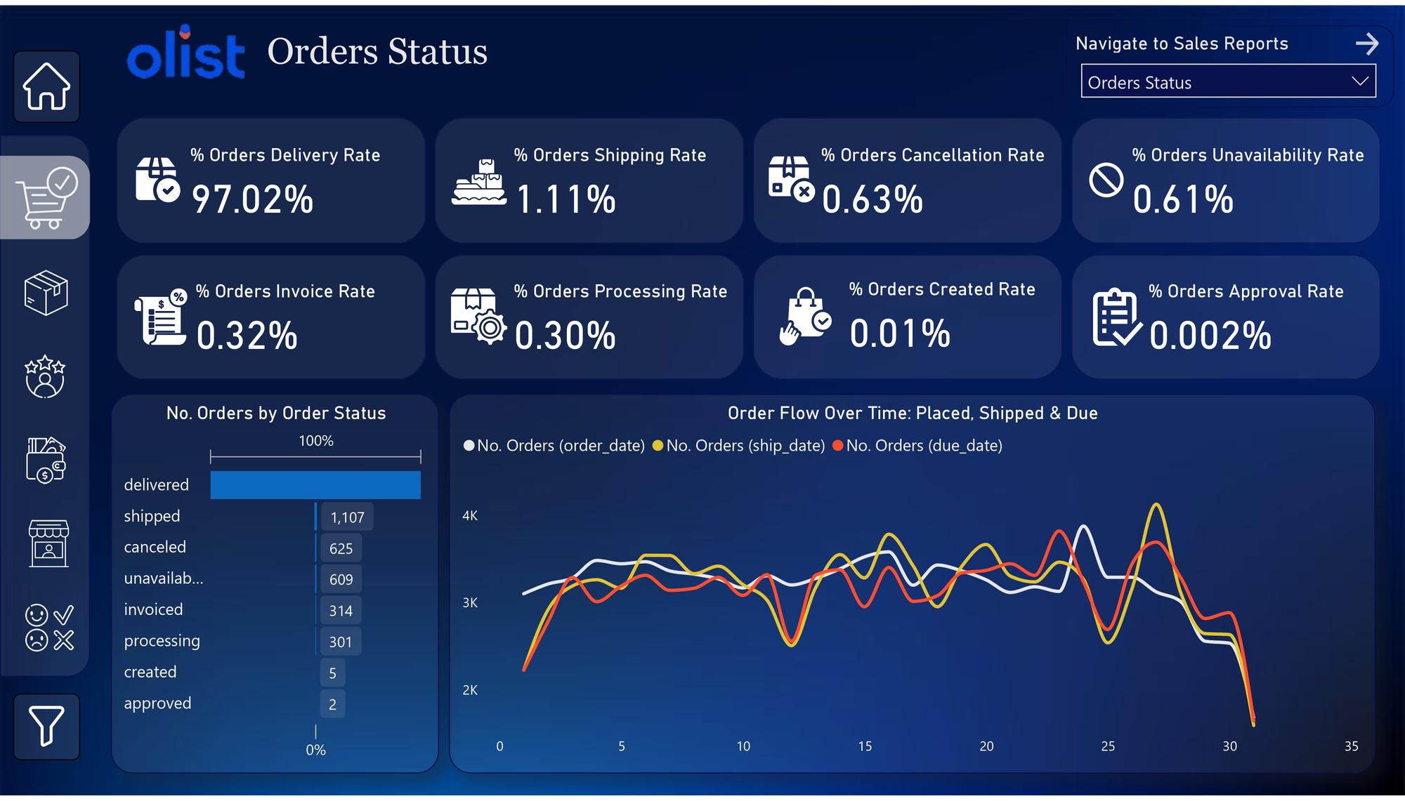
Recommendations:
Identify peak processing times and allocate resources efficiently to avoid shipping bottlenecks.
97.02% of orders are successfully delivered, 1.11% shipping rate, investigate the remaining 2.98% undelivered orders to understand any potential delays.
Optimize shipping workflows to increase the shipping rate, ensuring faster fulfillment.
ITP - Q2 - PBI - 2025
ITI MANSOURA

Slide 30
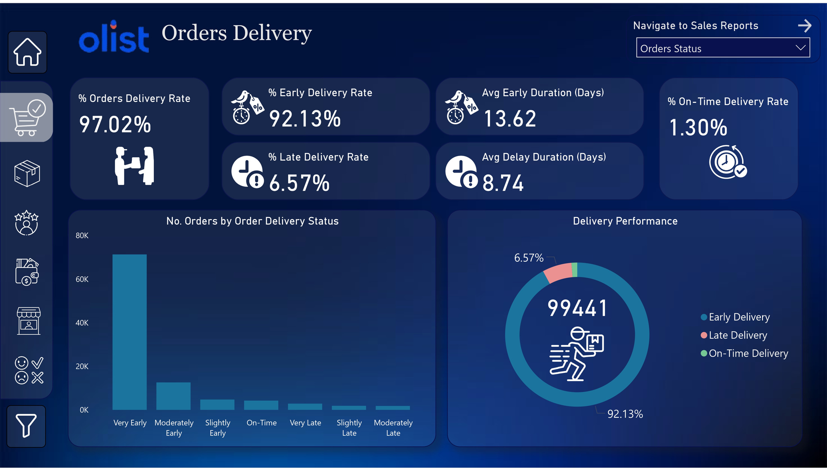
Recommendations:
Segment late deliveries by region, vendor, and logistics provider to pinpoint problem areas.
Implement a proactive alert system for at-risk deliveries to take corrective action before orders become late.
ITP - Q2 - PBI - 2025
ITI MANSOURA

Slide 31
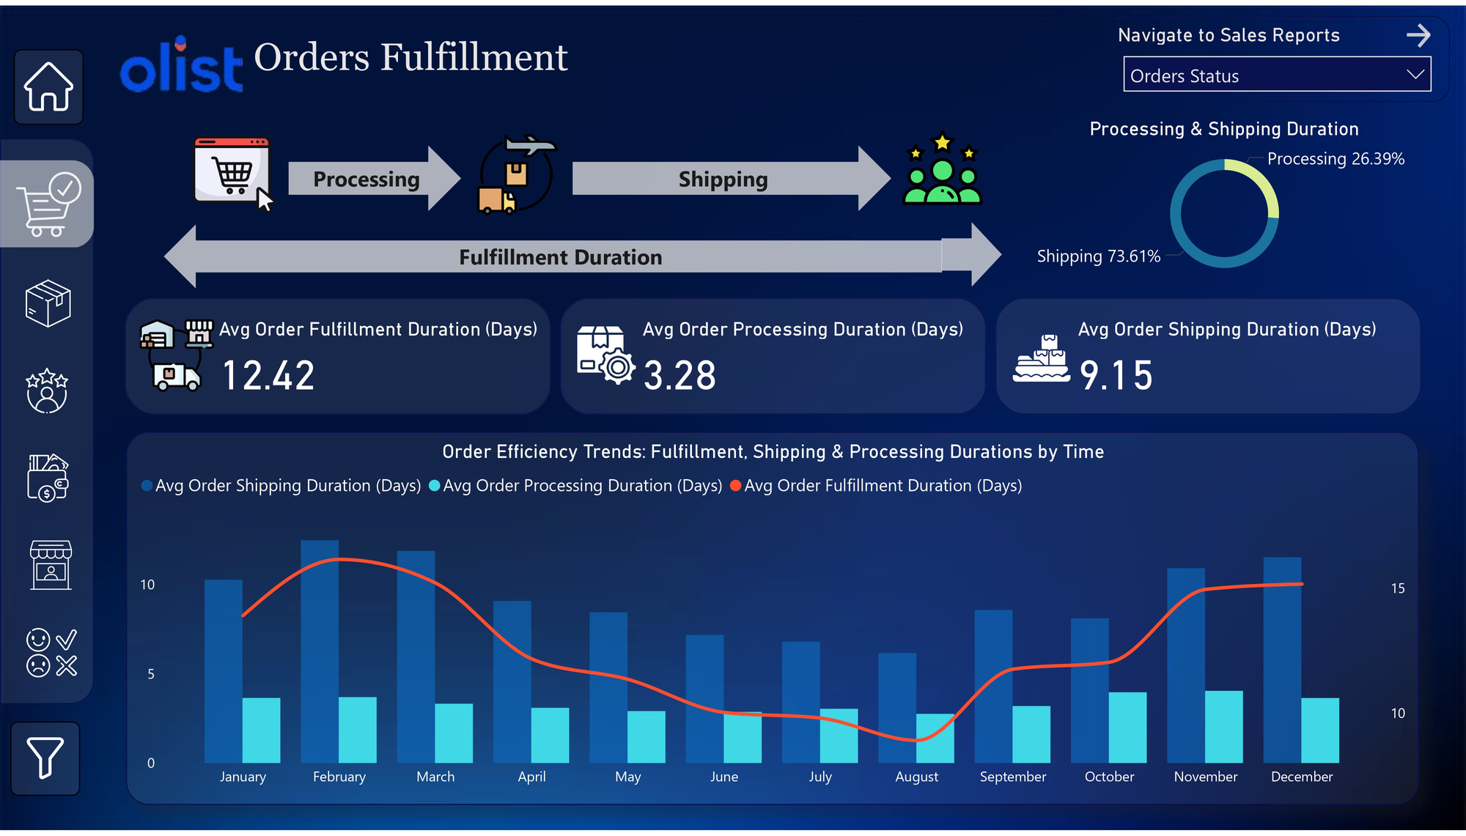
Recommendations:
Explore local warehouses or centers to store products closer to customers for faster delivery.
Reduce shipping time by optimizing logistics partnerships
Analyze peak season bottlenecks (e.g., supplier delays, warehouse congestion, courier capacity).
ITP - Q2 - PBI - 2025
ITI MANSOURA

Slide 32
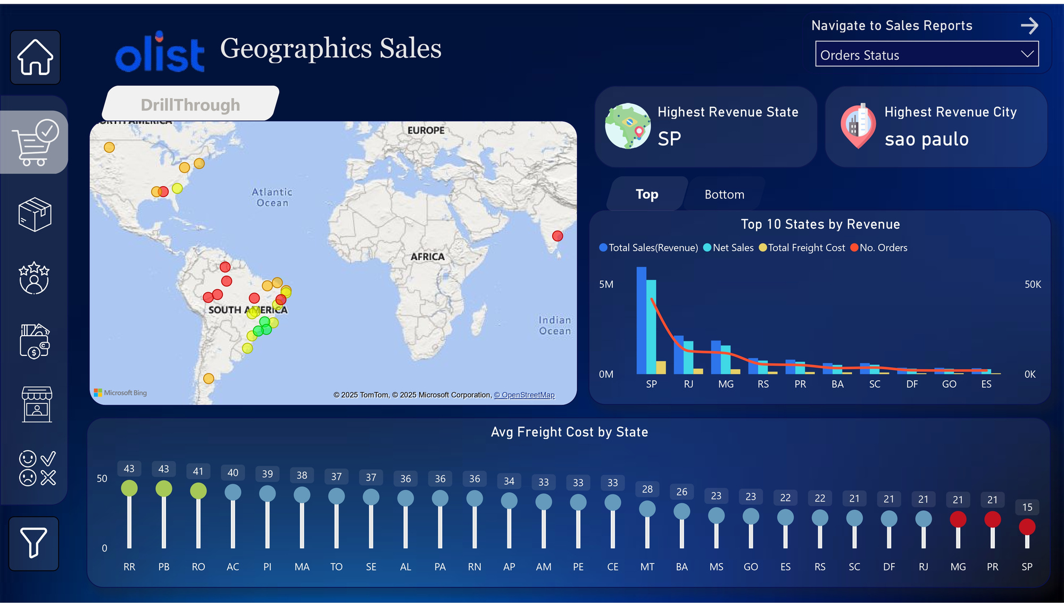
Recommendations:
Expand into lower-revenue regions with targeted marketing and partnerships.
Enhance logistics in high-order states to maintain customer satisfaction and delivery efficiency.
Reduce freight costs in expensive states by optimizing warehouse locations and carrier agreements.
ITP - Q2 - PBI - 2025
ITI MANSOURA

Slide 33
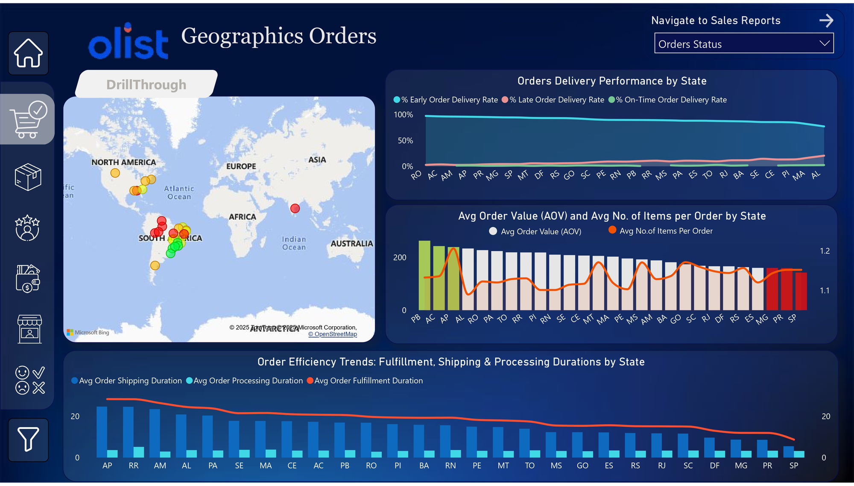
Recommendations:
Optimize delivery logistics in states with high late delivery rates by partnering with faster carriers.
Offer discounts for bulk purchases in states with higher AOV to retain high-value customers.
Implement automated order processing systems to reduce fulfillment durations in states with slow processing times.
ITP - Q2 - PBI - 2025
ITI MANSOURA

Slide 34
PRODUCTS DASHBOARDS
ITP - Q2 - PBI - 2025
ITI MANSOURA

Slide 35
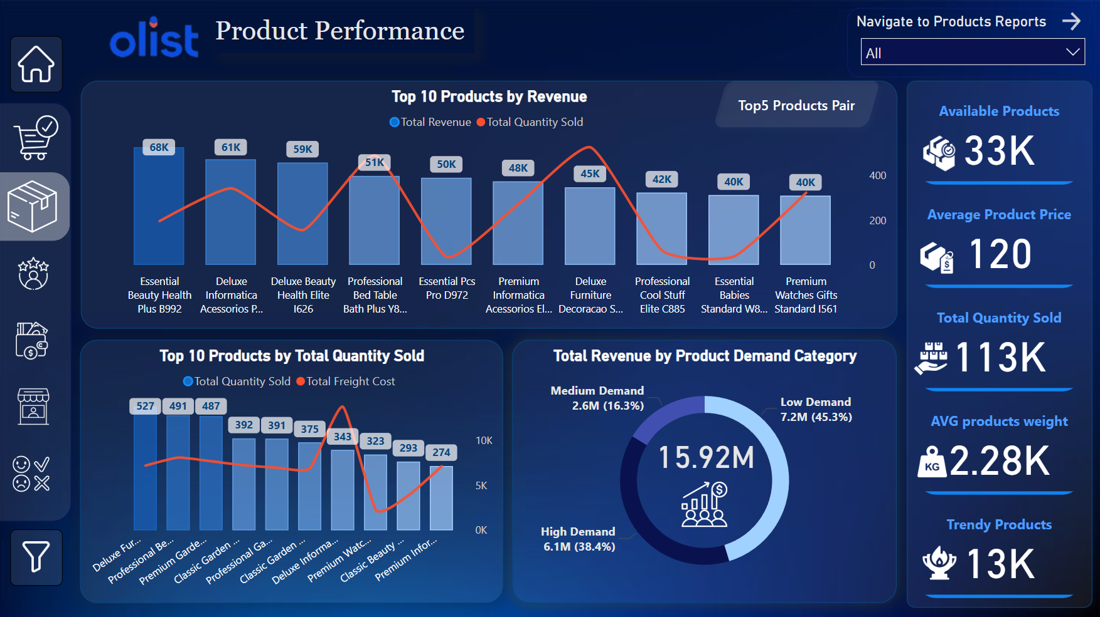
Recommendations:
Increase the price slightly for high-demand products to improve revenue without impacting sales.
Ensure that top-performing high-demand products are always in stock.
Identify products with high freight costs and negotiate better deals with suppliers.
Offer discounts for frequently paired products (e.g., Informatica Accessories Bundle, Automotive Kit).
ITP - Q2 - PBI - 2025
ITI MANSOURA

Slide 36
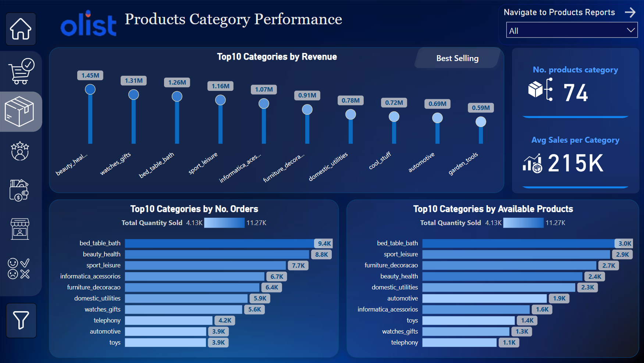
Recommendations:
Optimize Inventory for High Order Categories.
Highlight these categories in "limited-time offers" sections or push through email marketing.
Enhance SEO & product descriptions for Toys, Telephony, and Watches & Gifts to increase visibility.
ITP - Q2 - PBI - 2025
ITI MANSOURA

Slide 37
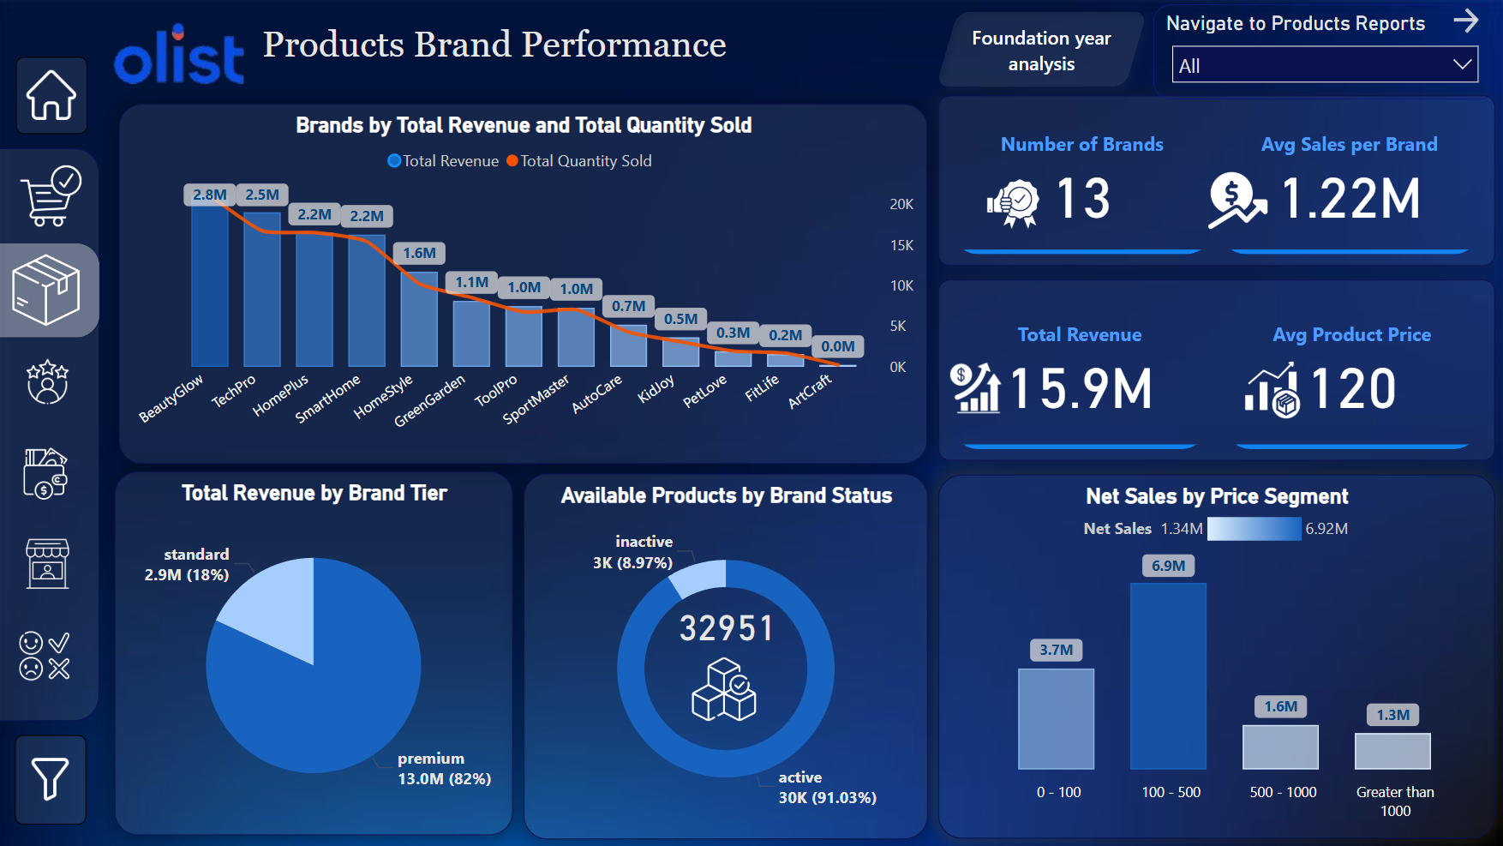
Recommendations:
Since 82% of revenue comes from premium brands, focus on high-end advertising, personalized offers & VIP loyalty programs.
Use brand collaborations & social media influencers to amplify reach.
Increase visibility on search filters & recommendation engines.
ITP - Q2 - PBI - 2025
ITI MANSOURA

Slide 38
CUSTOMERS DASHBOARDS
ITP - Q2 - PBI - 2025
ITI MANSOURA

Slide 39
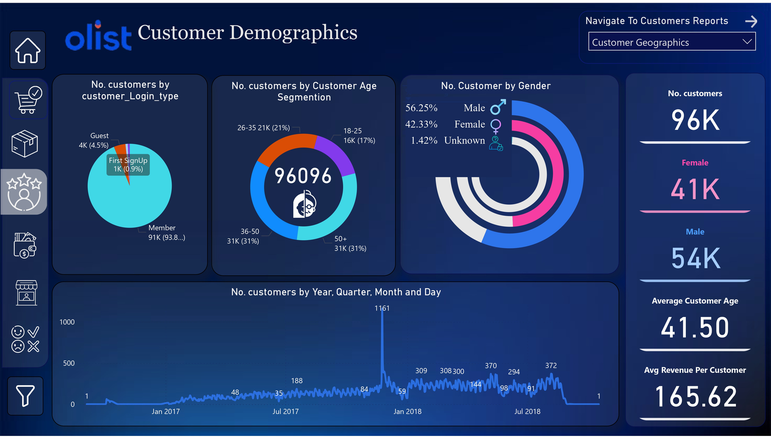
Recommendations:
Seasonal Promotions: with a drop in September and October. Plan marketing campaigns to boost sales .
Improve Guest Conversion: Guest login (3,946). Encourage account creation with perks like faster checkout or first-time discounts.
Provide instant welcome discounts for first-time users.
ITP - Q2 - PBI - 2025
ITI MANSOURA

Slide 40
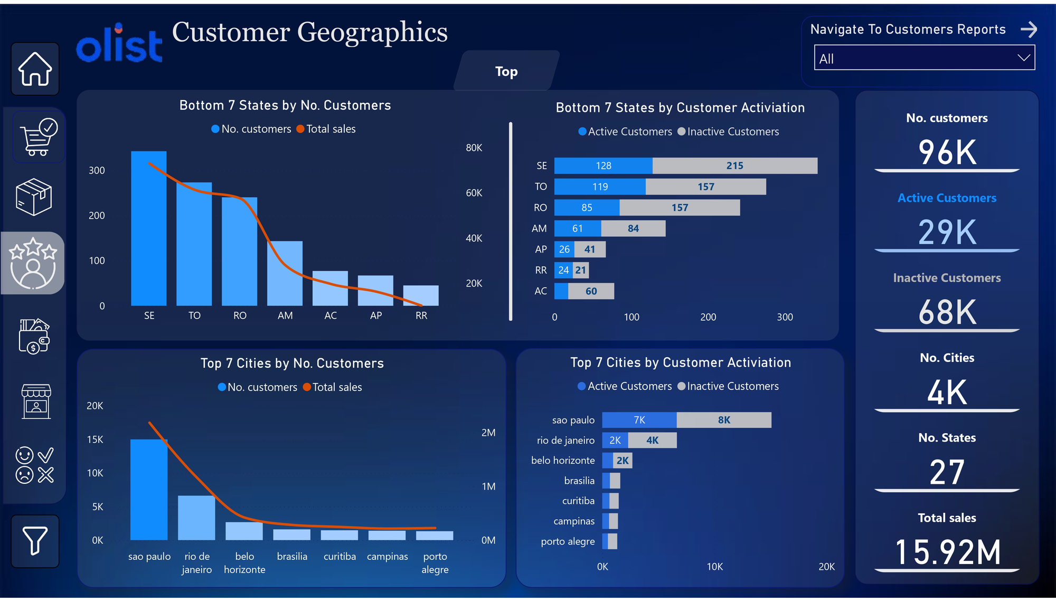
Recommendations:
Activate Inactive Customers: Offer exclusive promotions for inactive users to encourage purchases.
Optimize logistics and delivery times in High-Potential regions for better customer satisfaction.
Increase Customer Lifetime Value (CLV): offer repeat buyers VIP rewards bundling products or offering volume discounts.
ITP - Q2 - PBI - 2025
ITI MANSOURA

Slide 41
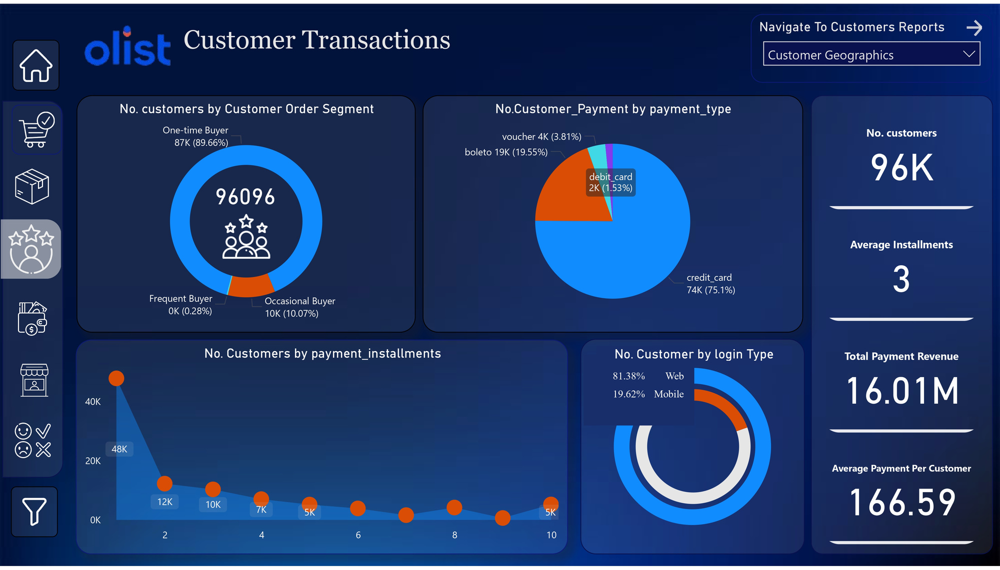
Recommendations:
Convert One-Time Buyers into Frequent Buyers: Offer special discounts for second purchases.Implement subscription-based offers for frequently bought products.
Increase Mobile Transactions: Improve mobile UI/UX and ensure a fast. mobile-exclusive discounts to increase mobile transactions.
Increase Payment per Customer: Offer limited-time discounts on premium products
ITP - Q2 - PBI - 2025
ITI MANSOURA

Slide 42
PAYMENT METHODS DASHBOARDS
ITP - Q2 - PBI - 2025
ITI MANSOURA

Slide 43
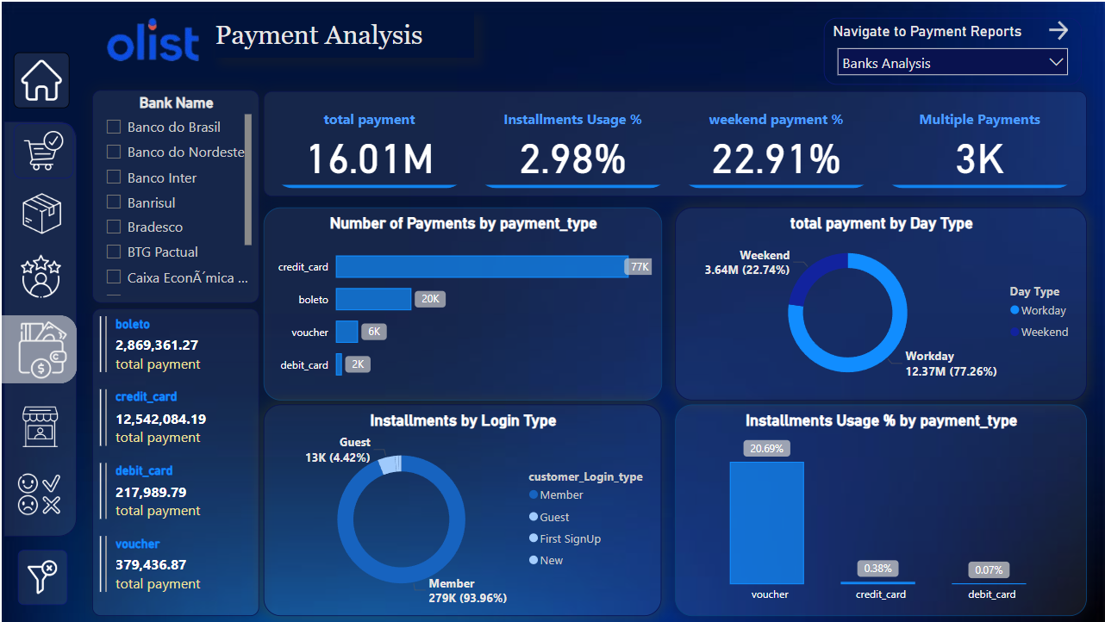
Recommendations:
Promote Credit Card Payments for Higher Revenue: Offer discounts or cashback for credit card users to encourage more usage.
Boost Weekend Sales with Promotions: Launch exclusive weekend flash sales or discounts to increase weekend revenue.
ITP - Q2 - PBI - 2025
ITI MANSOURA

Slide 44
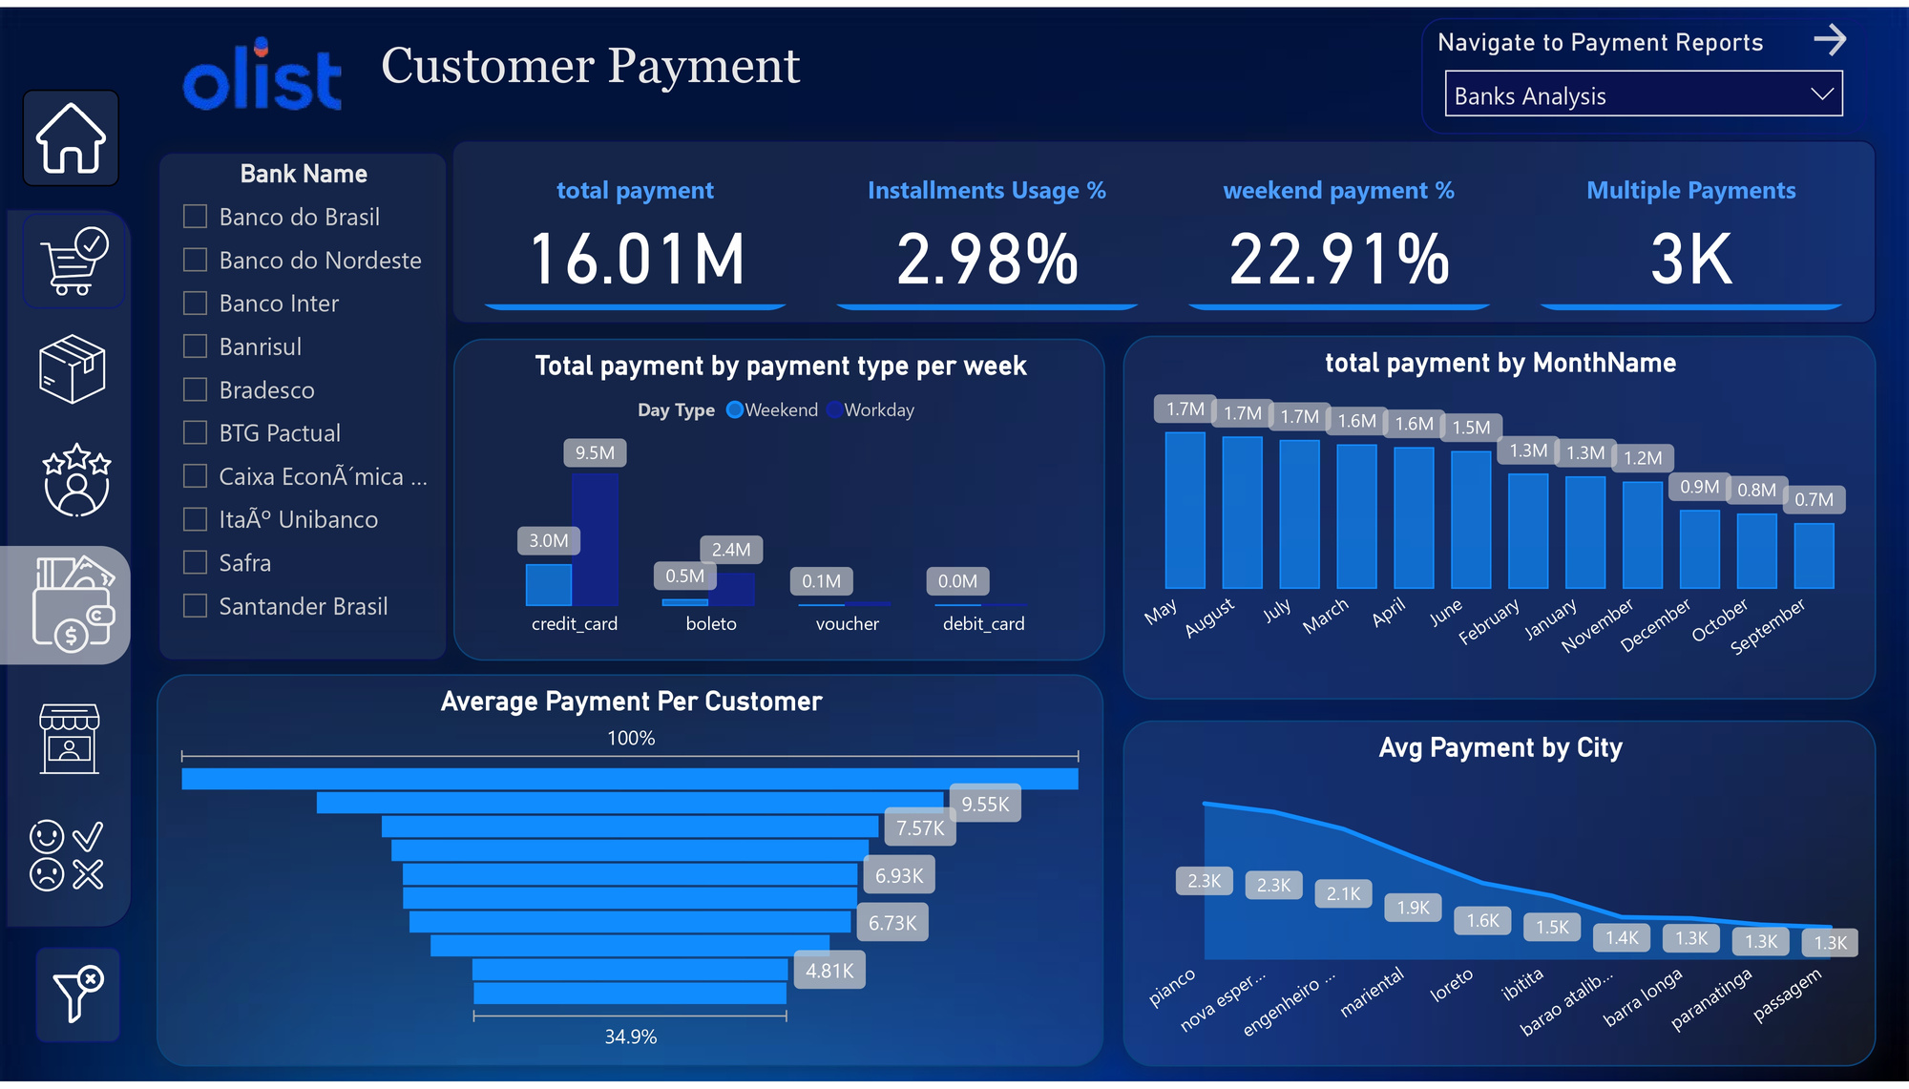
Recommendations:
Target High-Payment Cities for Premium Offers: Offer exclusive VIP memberships or premium products in these locations.
Increase Sales in Low-Payment Months: Implement seasonal campaigns, discounts, or bundle deals during these months.
ITP - Q2 - PBI - 2025
ITI MANSOURA

Slide 45
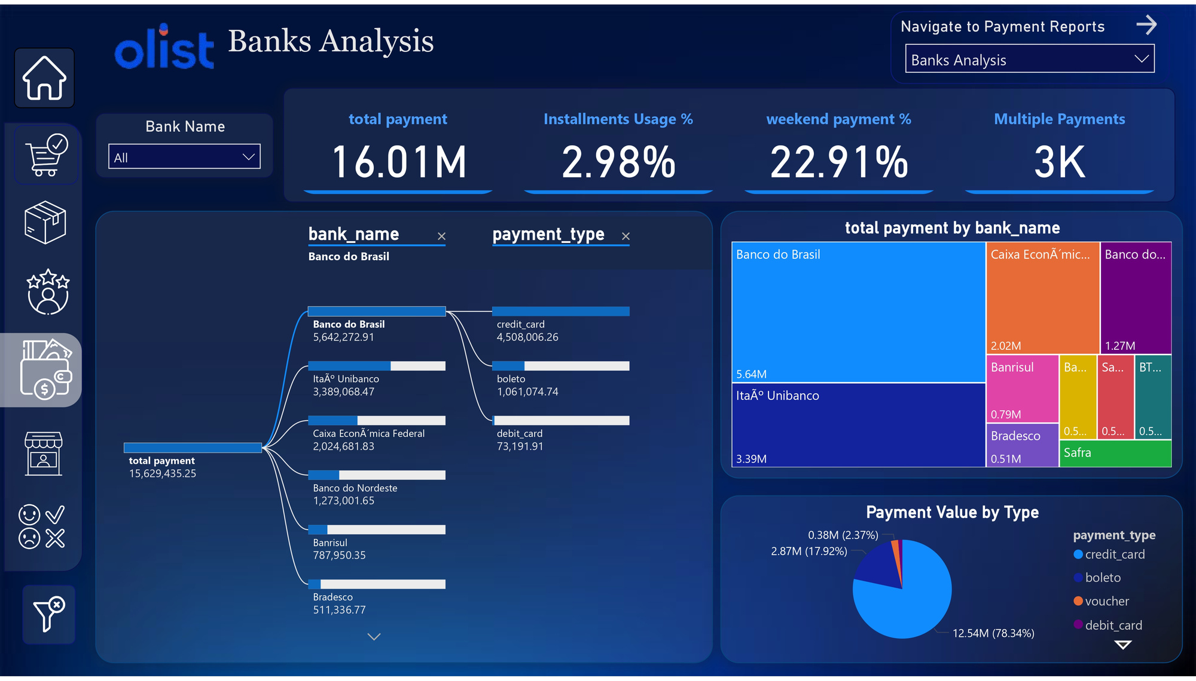
Recommendations:
Strengthen Partnerships with Top Banks: Offer exclusive discounts or faster payment processing for customers using these banks.
Target Smaller Banks for Growth: Launch co-branded promotions with these banks to attract new users.
ITP - Q2 - PBI - 2025
ITI MANSOURA

Slide 46
SELLERS DASHBOARDS
ITP - Q2 - PBI - 2025
ITI MANSOURA

Slide 47
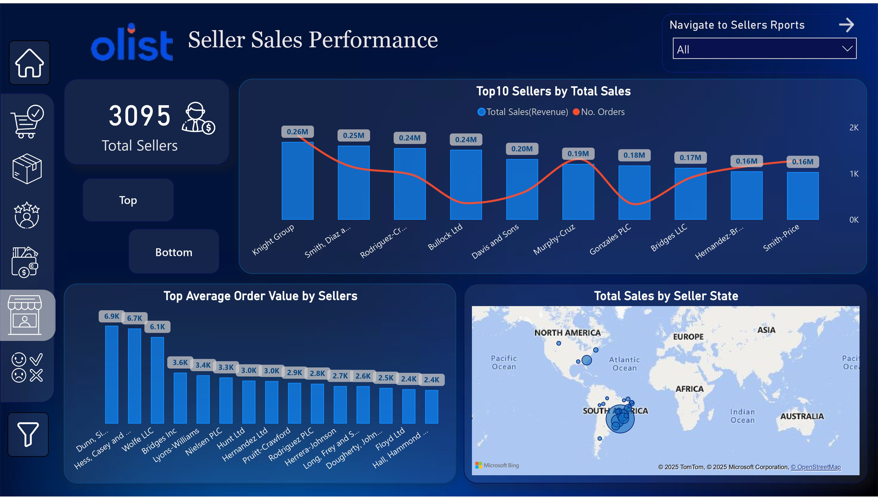
Recommendations:
Discount Bundles: Offer tech bundles for Bullock Ltd and Gonzales PLC Sellers passed on Product Category .
Expand in AM, RO, AC: Run localized ads and reduce shipping costs to boost sales.
Loyalty & Flash Sales: Launch a rewards program and time-limited deals to drive repeat purchases.
ITP - Q2 - PBI - 2025
ITI MANSOURA

Slide 48
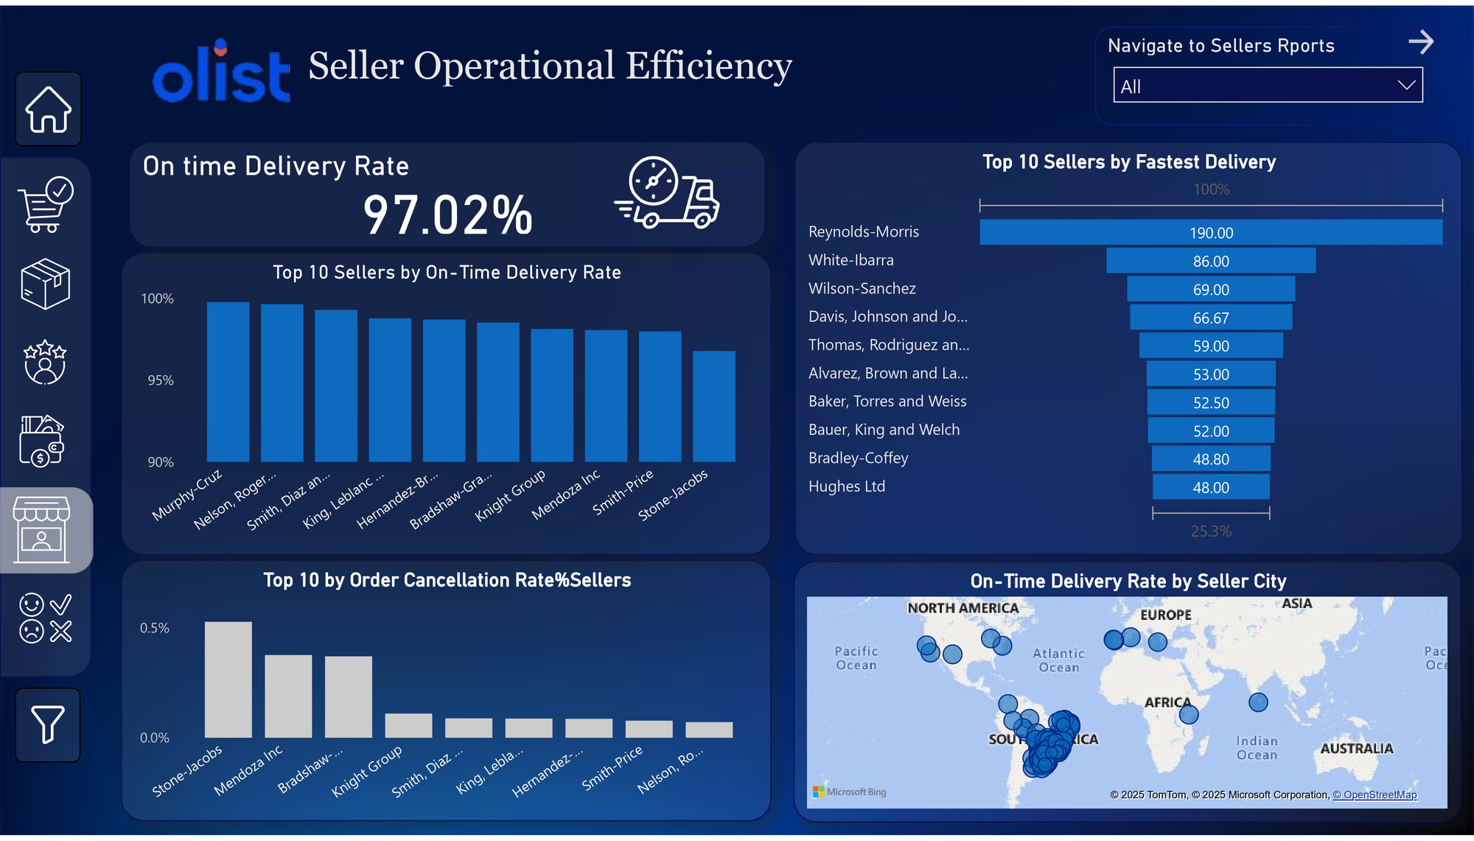
Recommendations:
Reduce Cancellation Rate: Investigate and improve Stone-Jacobs and Mendoza Inc.'s order fulfillment
Enhance Delivery Speed: Support slowest sellers with logistics optimization and better carrier partnerships.
Maintain High On-Time Delivery: Ensure top-performing sellers sustain efficiency with performance incentives.
ITP - Q2 - PBI - 2025
ITI MANSOURA

Slide 49
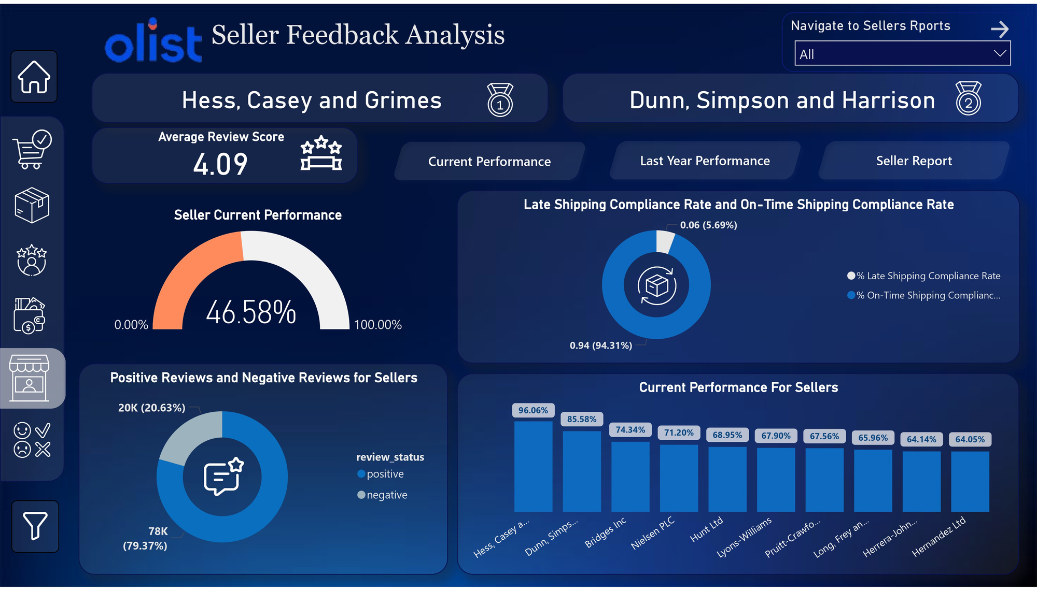
Recommendations:
Improve Seller Performance: Focus on boosting Hess, Casey, and Grimes' performance .
Reduce Late Shipping: Address the 5.69% late shipping compliance rate to enhance customer satisfaction.
Enhance Review Scores: Increase positive feedback by improving service quality and delivery efficiency..
ITP - Q2 - PBI - 2025
ITI MANSOURA

Slide 50
REVIEWS DASHBOARDS
ITP - Q2 - PBI - 2025
ITI MANSOURA

Slide 51
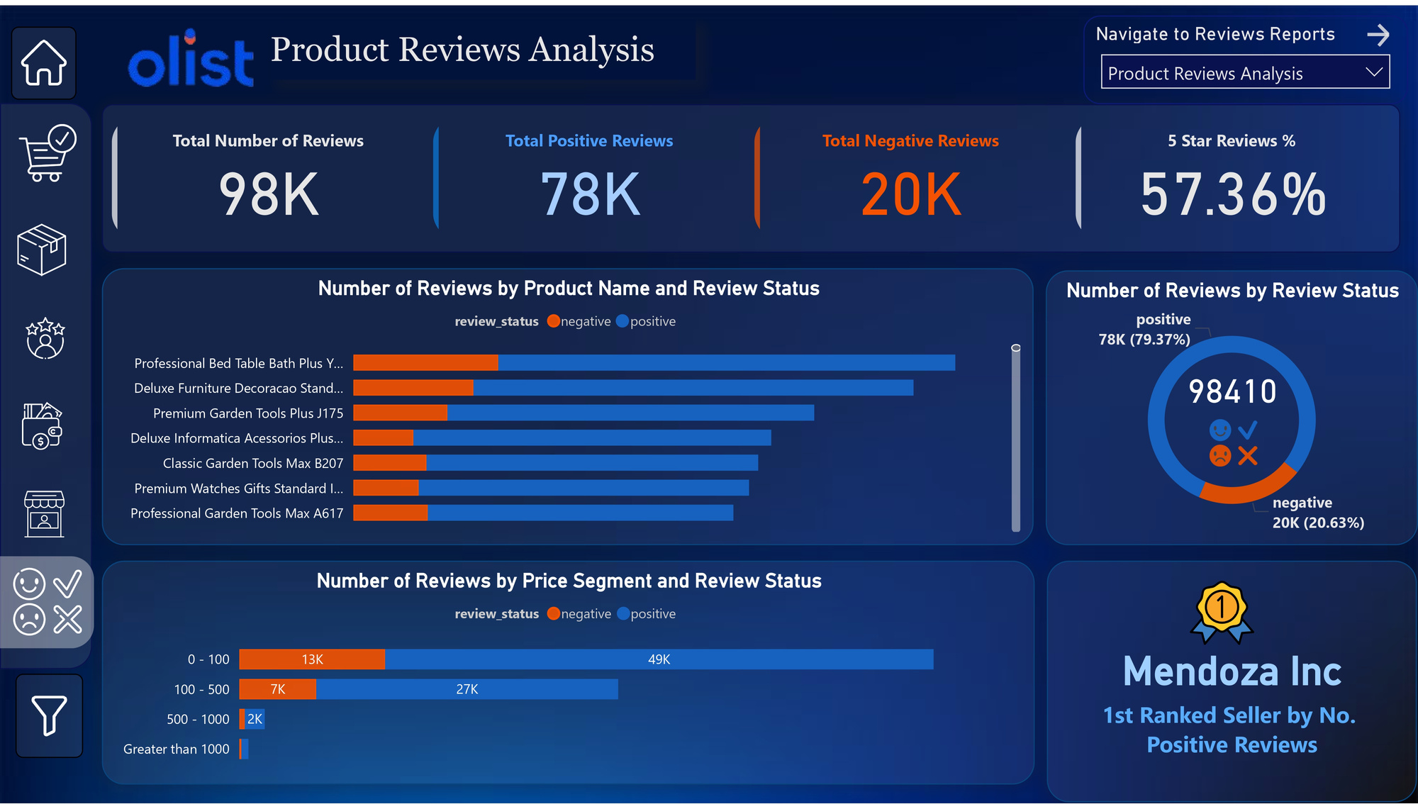
Recommendations:
Investigate common complaints and improve product quality or service.
Mendoza Inc. is the top-rated seller. Highlight their products in ads, homepage features, or exclusive deals.
ITP - Q2 - PBI - 2025
ITI MANSOURA

Slide 52
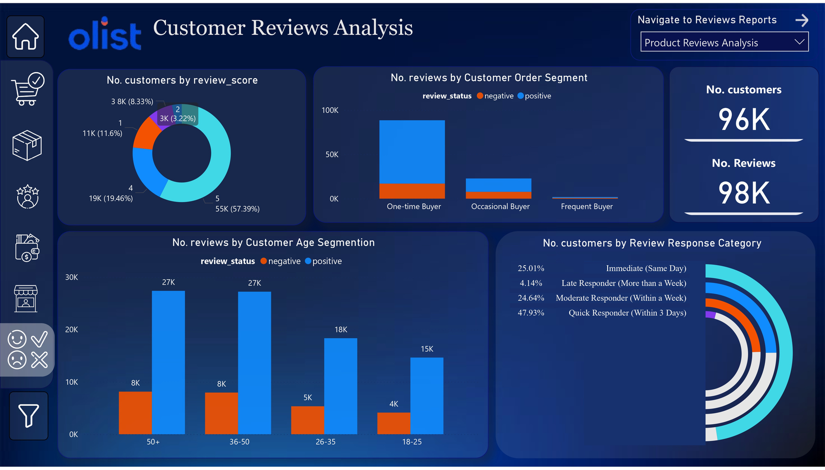
Recommendations:
Increase Positive Reviews: analyze common complaints and fix product/service problems.
Focus on 50+ and 36-50 Age Groups for Engagement: provide the most reviews, meaning they are active customers—use targeted offers and personalized campaigns to retain them.
Leverage Positive Reviews for Marketing: Highlight high-rated products in advertisements and social media.
ITP - Q2 - PBI - 2025
ITI MANSOURA

Slide 53
10) TABLEAU DASHBOARDS
ITP - Q2 - PBI - 2025
ITI MANSOURA

Slide 54
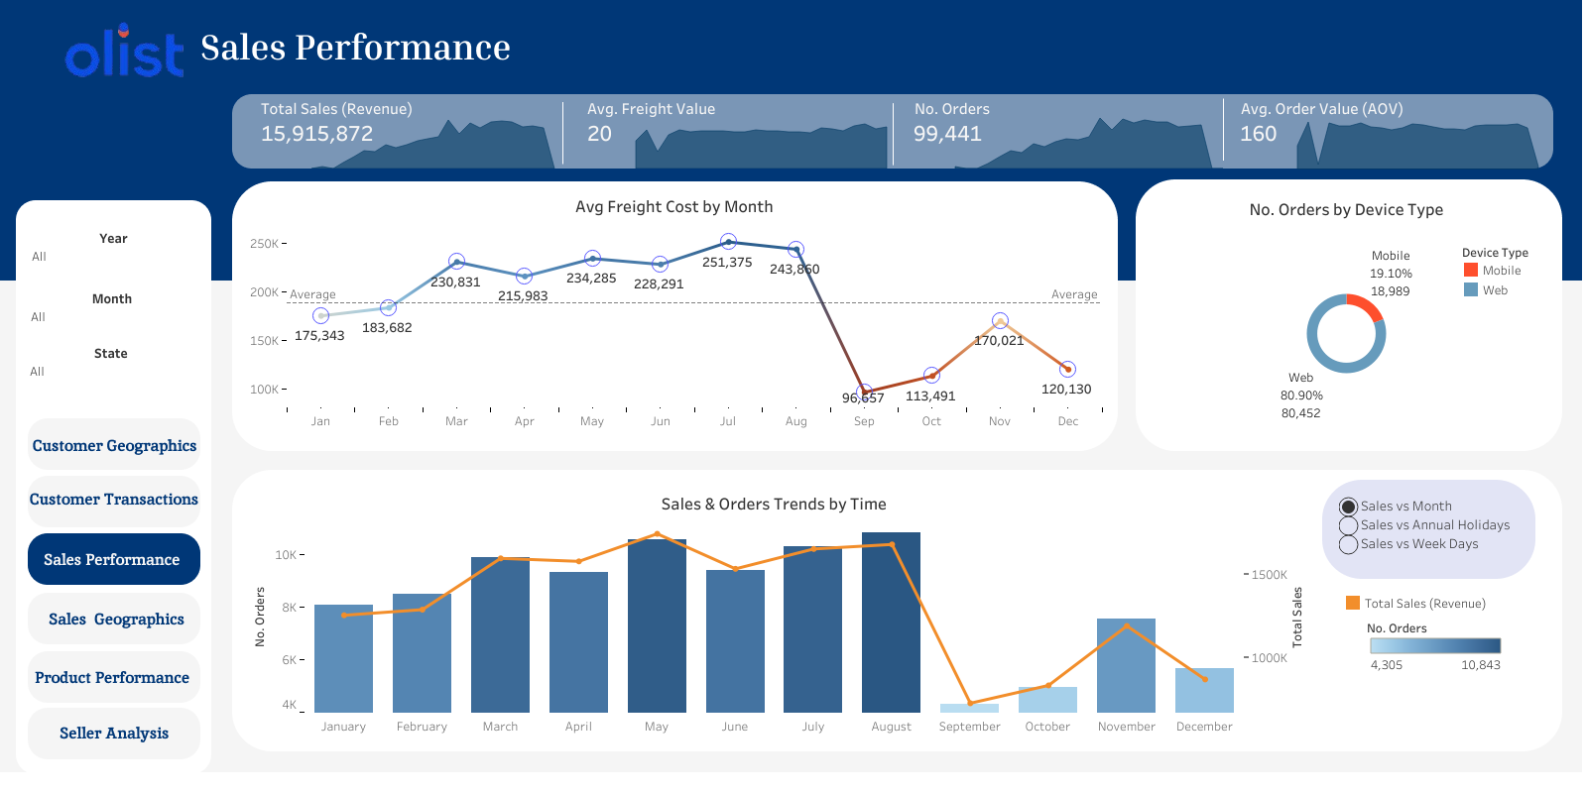
Recommendations:
• Run seasonal discounts to address the sharp drop in September.
• Optimize the mobile purchasing experience by improving app UI,
streamlining checkout, and offering exclusive mobile promotions.
ITP - Q2 - PBI - 2025
ITI MANSOURA

Slide 55
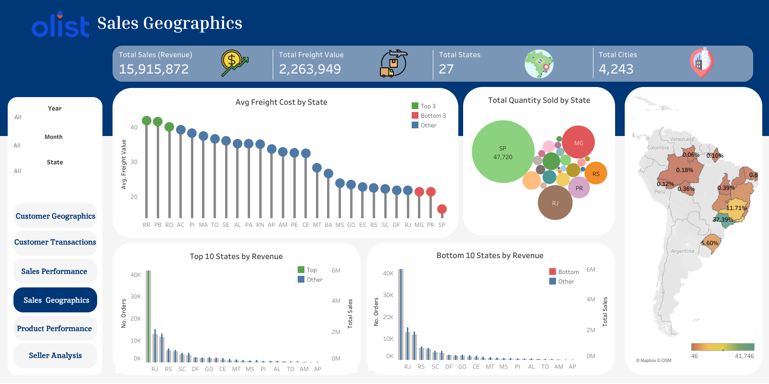
Recommendations:
• Negotiate better shipping rates in High-Cost States RR, PB, RO
to reduce logistics expenses.
• Expand Market Share in Low-Performing States (AP, AL, GO).
• Improving seller efficiency in MG, RJ, and RS could further boost sales.
ITP - Q2 - PBI - 2025
ITI MANSOURA

Slide 56
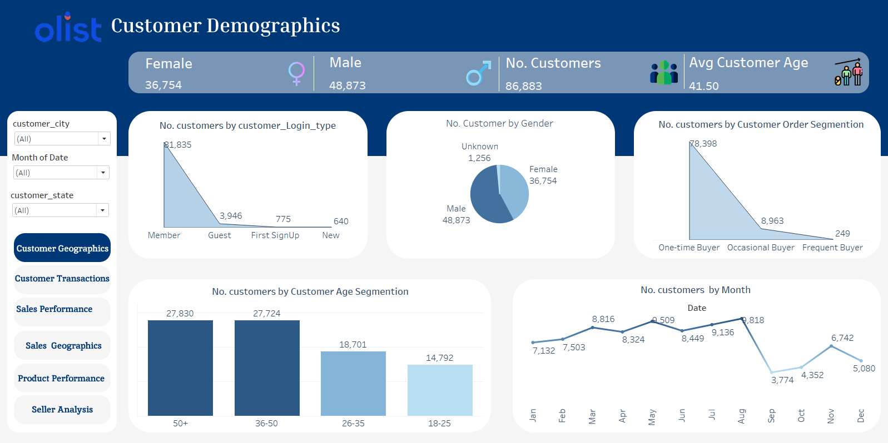
Recommendations:
Seasonal Promotions: with a drop in September and October. Plan marketing campaigns to boost sales .
Improve Guest Conversion Guest login (3,946). Encourage account creation with perks like faster checkout or first-time discounts.
Analyze Customer Location: Utilize customer city and state to create localized marketing strategies.
ITP - Q2 - PBI - 2025
ITI MANSOURA

Slide 57

Recommendations:
Improve Customer Satisfaction: especially in the 50+ age group (5,748 negative reviews). Improve product quality and customer service for this segment.
Leverage Customer Reviews: Since 50,494 customers gave a rating of 5, use these testimonials in marketing to build trust.
Optimize Marketing by Location: The state of SP has the highest number of customers. Focus marketing efforts and promotions in high-performing states.
ITP - Q2 - PBI - 2025
ITI MANSOURA

Slide 58

Recommendations:
Expand High-Performing Categories: Invest in marketing and stock availability for Beauty & Personal Care as it drives the most revenue.
Reevaluate Low-Performing Brands: Brands like FitLife, PetLove, and ArtCraft need promotional support or should be replaced with higher-demand brands.
ITP - Q2 - PBI - 2025
ITI MANSOURA

Slide 59

Recommendations:
Top Sellers Focus: Prioritize high-performing sellers like Knight Group and Smith, Diaz, and Thomas to boost overall sales.
Regional Sales Strategy: Target high-order states like São Paulo for further growth while improving sales in lower-performing regions.
Regional Sales Insights: Focus on high-performing states like São Paulo to identify best practices and apply them to lower-performing regions, boosting overall sales and seller success.
ITP - Q2 - PBI - 2025
ITI MANSOURA

Slide 60

Trello Work Environment
Trello facilitated clear communication and assignment of responsibilities among the team members
ITP - Q2 - PBI - 2025
ITI MANSOURA

Slide 61
Any Questions?

Slide 62
THANK YOU

